Slide 1
Welcome to
Safe Church
Mandatory Reporting
(Ministry Agents)
Training
Notes:
Welcome to Safe Church – Mandatory Reporting for Ministry Agents Training.

Slide 2
Purpose
To apply knowledge:
From the Ministry Agents Foundations module.
Through responding to real-life scenarios.
Notes:
This training is a workshop, with the purpose of applying knowledge from the Ministry Agents Foundation module through responding to real-life scenarios.

Slide 3
WARNING
Information may be unsettling, challenging, confronting or distressing.
It is important you are safe and seek support from someone you trust.
Notes:
WARNING
Information includes talk of abuse, neglect and grooming.
It may be unsettling, challenging, confronting or distressing.
It may trigger memories, cause flashbacks or remind you of events you or others have experienced.
It is important you are safe and seek support from someone you trust.

Slide 4
 | Read the Scenario
Consider how you might respond.
 | Discuss the questions and come to a group answer.
Nominate a spokesperson to share your insights with the wider group.
Notes:
In the workshop today, you will apply your knowledge and learnings to real-life scenarios.
We encourage you to engage in active listening and be involved in your group discussion.
You will receive a scenario with some questions.
Read the scenario as a wider group.
Consider how you might respond.
Discuss the questions and come to a group answer.
Nominate a spokesperson to share your insights with the wider group.
You will be given a reminder 5 minutes and 1 minute before we come back together.

Slide 5
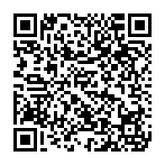
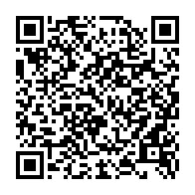
Scenario 1
CHURCH FETE
C2.1.5.3 Mandatory Reporting for Ministry Agents | C2.1.2.7.2 List of Unacceptable Behaviours
Notes:
Let’s read through the first scenario. You will receive a copy in your groups.
[Optional – please use this time to access the documents listed, or the codes are available with the scenarios]
It’s Saturday and your Church is holding a fete. Many congregation members are on-site early to set up and Emma (fete co-ordinator) has given people various jobs to do. James (42 year old, single male) and Sam (17 year old, male) have gone out to the front of the Church to put signs up on the lawn.
After a short time, Sam comes to Emma and says, "I'm not working with James anymore. He just showed me some pictures on his phone that I really didn't want to see." Emma asked Sam “what type of pictures were they?” Sam replied, “Let's just say girls without much on.”
Sam says that he'll go work with Ronda and other people, which Emma agrees with. At the end of the fete Emma uses the Speak Up! QR code to submit an internal report.
A week goes by, and Sam submits an internal report indicating that James has shown him a video after Church on Sunday with similar content to the pictures shown at the fete.
[Break into groups of 3-4. Click to next slide while groups are collaborating]

Slide 6
 | Read Scenario 1
Consider how you might respond.
 | Discuss the questions and come to a group answer.
Nominate a spokesperson to share your insights with the wider group.
Notes:
[Reminders 5 mins and 1 min before regrouping]
Invite each nominated spokesperson to share
[One question at a time, or call upon groups to answer different questions]
[The following are possible guiding questions / responses]
1. What policy breach and type of abuse and/or harm is being alleged in this scenario?
Which aspects of the Safe Church policy were being breached?
Sexual abuse.
Grooming (may be possible).
Emotional harm.
Psychological harm.
Breach of Policy – child under 18 alone with an adult.
Breach of Policy - adult volunteer is out of line-of-sight of other volunteers.
2. What additional steps could Emma have taken after Sam informed her of the incident?
Would she have spoken with James?
Would she have asked another adult to keep an eye on James or Sam’s interactions during the fete?
Inform Ministry Agent (if at event).
Perhaps ask Sam to stay with people he trusts during the fete and let her know of any further concerns.
Remind leaders/adults to adhere to adult-participant ratios, line-of-sight etc.
3. What actions should you take as the Ministry Agent?
What actions might have happened during the week between incidents?
What action do you take if you know there has been a second incident?
Offer Pastoral Care to Emma, Sam and James.
Speak with James, inform of unacceptable behaviour.
Continue monitoring behaviour and actions, as a third could be suspected grooming and require reporting externally.
4. Should Sam’s parents be informed?
Yes. As Sam is under 18, parents are to be informed that an incident has occurred.
Maintain privacy of all people involved.

Slide 7
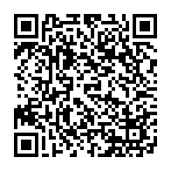
Scenario 2
YOUTH GROUP
C2.1.5.3 Mandatory Reporting for Ministry Agents | C2.1.5.8 Reporting and Referral Guide
Notes:
Let’s read through the second scenario.
It’s Friday night and you attend the Youth Group as a guest speaker. At the end of the night, all the youth have headed home and the leaders are chatting. Amelia (20 year old, female), a Youth Group leader, reveals that her mother frequently yells at her and calls her derogatory names at home. Amelia admits this has been happening for the last 5 years.
As the Ministry Agent you know that Amelia’s parents are active Church members. Her mother is the Church Council Secretary, and her father is a member of the property committee.
As the conversation continues among the Youth Group leaders, Amelia shares that she’s worried about her younger brother, Matthew (14 year old, male), as she often hears her mother yelling at him too and calling him names. Amelia is afraid and doesn’t want to report this to the police.
[Break into groups of 3-4. Click to next slide while groups are collaborating]

Slide 8
 | Read Scenario 2
Consider how you might respond.
 | Discuss the questions and come to a group answer.
Nominate a spokesperson to share your insights with the wider group.
Notes:
[Reminders 5 mins and 1 min before regrouping]
Invite spokespeople to share
[One question at a time, or call upon groups to answer different questions]
[The following are possible guiding questions / responses]
1. What type of abuse and/or harm is/was Amelia experiencing?
Verbal abuse.
Domestic and Family Violence. [Emotional abuse – constant put downs, name calling, humiliation]
Psychological harm.
Emotional harm.
2. What would you say to Amelia?
What comfort would you provide?
How could you gently ask if she has a safe place to go to?
How could you ask if her brother is in immediate danger?
R.E.S.P.O.N.D to the disclosure.
Reassure her it was the right thing to do to share.
Let her know reporting to Child Protection authorities may need to occur.
3. What actions should you take as a Ministry Agent?
Do you need to complete external reporting? To which agency?
What support should be offered to Amelia?
Would there be any action due to Amelia’s mother’s leadership role (Church Council Secretary)?
If any imminent danger, call 000.
Submit internal report.
Complete C2.1.5.3 Threshold Test.
Follow link to external Queensland Child Protection Guide and complete decision tree. Follow prompts as it arises.
Record all communication.
Provide Amelia with appropriate referrals (using Reporting and Referral Guide).
Offer Amelia Pastoral Care.
Follow-up with youth group leaders to debrief.
4. In your opinion, what support or actions could be offered for the rest of the family?
Amelia’s brother?
Amelia’s father?
Amelia’s mother?
Offer Pastoral Care for all family members (this may be offered by different people)

Slide 9
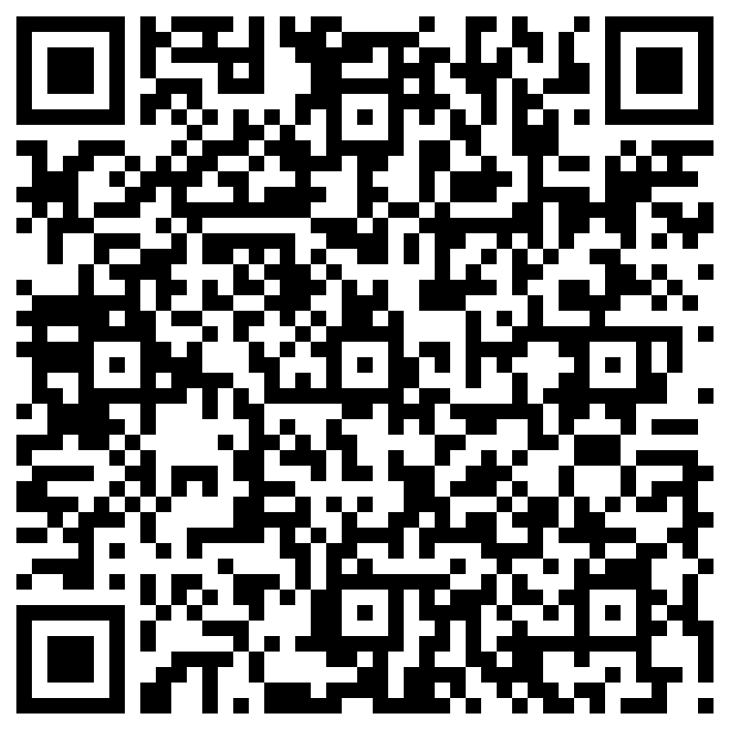
Ministry Agents
Confirm you completed the module:
Scan the QR code.
Complete the form.
Notes:
To aid with record keeping, all Ministry Agents need to scan this QR code and complete the form.
This will be accessible by your Presbytery to prove you have completed this module.

Slide 10
Thankyou!
Resources on The Hub:
hub.ucaqld.com.au
Contact Safe Church Unit:
safechurch@ucaqld.com.au
(07) 3377 9833
Notes:
Thank you so much for your time and effort with the training.
Safe Church resources can be found on The Hub.
Connect with the Safe Church Unit if you have any questions.

