Slide 1
Welcome to
Safe Church
Person of Concern
Training
Notes:
Welcome to Safe Church – Person of Concern Training.

Slide 2
Purpose
To gain an understanding of:
Who is a Person of Concern.
Processes for a Person of Concern.
Safety Agreements.
Reporting requirements.
Notes:
The purpose of this module is to gain an understanding of:
Who is a Person of Concern.
Process for a Person of Concern.
Safety Agreements.
Reporting requirements.

Slide 3
SAFE PROGRAMS
SAFE PARTICIPANTS
SAFE BEHAVIOUR
Safe Church
SAFE PEOPLE
Notes:
This module focuses on Safe Participants.
[If done separately to other modules explain the following
Safe People focuses on our volunteers.
Safe Behaviour focuses on actions and reporting.
Safe Programs focuses on the activities and guidelines.
Safe Participants focuses on attendees.]

Slide 4
WARNING
Information may be unsettling, challenging, confronting or distressing.
It is important you are safe and seek support from someone you trust.
Notes:
WARNING
Information includes talk of abuse, neglect and grooming.
It may be unsettling, challenging, confronting or distressing.
It may trigger memories, cause flashbacks or remind you of events you or others have experienced.
It is important you are safe and seek support from someone you trust.

Slide 5
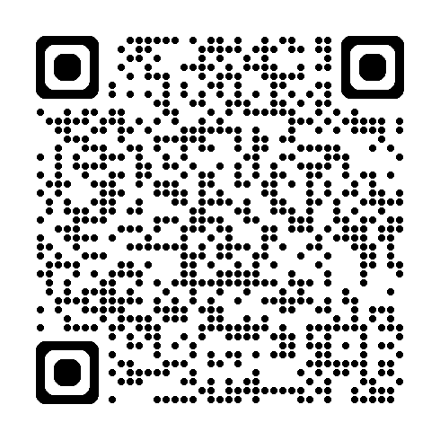
C2.4.1.1 Responding to a Person of Concern
Notes:
Please get a copy of ‘Responding to a Person of Concern’ – this will be used throughout the module.
[1pp or 1 shared between two]
[Assist people with getting a digital copy (scanning the QR code, searching the code (C2.4.1.1) on the Hub, or pass out paper copies]

Slide 6
Who is
A Person of Concern?
Notes:
Let’s start with some shared understanding.
From what you may know, who is a Person of Concern?

Slide 7
Definition – Person of Concern
A person wishing to attend a Congregation or Faith Community of the Uniting Church in Australia, who has engaged in or is suspected of harmful sexual behavior towards a child or adult, resulting in:
Criminal charges or conviction relating to sexual offences.
Placement on the register of sexual offenders.
Recorded on the National Coordinated Criminal History Check.
Blue/Exemption Card suspended, refused, or negative notice.
Concerns that the safety of others is at risk due to inappropriate sexual behaviour.
Notes:
The definition of a Person of Concern is a person wishing to attend a Congregation or Faith Community of the Uniting Church in Australia, who has engaged in or is suspected of harmful sexual behavior towards a child or adult, resulting in:
Criminal charges or conviction relating to sexual offences.
Placement on the register of sexual offenders.
Recorded on the National Coordinated Criminal History Check.
Blue/Exemption Card suspended, refused, or negative notice due to child-related activities.
Concerns in the Congregation, Faith Community, Presbytery or Synod that the safety of others is at risk due to inappropriate sexual behaviour

Slide 8
Identify Person of Concern (POC)
Complete Risk Assessment for POC
Recruit Monitors
Safety Agreement offered
POC to not attend Church
Accepted
Declined, withdrawn or not offered
Pastoral Care Provided
Maintain and Review
POC exits Church
Notes:
Here is a quick overview of the Person of Concern process.
Identify the Person of Concern. Ask them to refrain from attendance at Church events (activities, services, programs etc) or on Church property.
Complete a Risk Assessment to determine ability of Congregation to provide for all requirements.
Recruit monitors.
Safety Agreement offered.
The Person of Concern accepts Safety Agreement and can attend Church events with monitor present.
Maintain and review the Safety Agreement.
Note Pastoral Care is provided throughout this process, to all parties involved.
If the Person of Concern declines the Safety Agreement, it is withdrawn or not offered, they will exit the Church and Pastoral Care will cease.

Slide 9
Are they a Person of Concern? Why?
A person that has been charged with a child grooming offence.
A volunteer with two complaints of boundary violations made against them.
A Ministry Agent who has applied for their Blue Card and not yet received it.
Notes:
For the following scenarios, identify if they are a Person of Concern or not. Explain why.
1. A person that has been charged with a child grooming offence.
2. A volunteer with 2 complaints of boundary violations made against them.
3. A Ministry Agent who has applied for their Blue Card and not yet received it.
[Answers on next slide]

Slide 10
Are they a Person of Concern? Why?
A person that has been charged with a child grooming offence.
A volunteer with two complaints of boundary violations made against them.
A Ministry Agent who has applied for their Blue Card and not yet received it.
Person of Concern
Not a
Person of Concern
Not a
Person of Concern
Notes:
Answer:
1 – Person of Concern (as they have been charged with a child-related sexual offence).
2 – NOT a Person of Concern. However continued boundary violations lead to a Performance Improvement Plan, and any behaviours reported internally and externally if required.
3 – NOT a Person of Concern. They should not be involved in child-related activities until a positive Blue Card notice is received.

Slide 11
Pause and Reflect
A person advises the Church that they are prohibited from applying for a Blue Card.
What information would confirm they:
Are a Person of Concern?
Are NOT a Person of Concern?
Notes:
Let’s pause and reflect.
If a person advises the Church that they are prohibited from applying for a Blue Card, they are considered as a Person of Concern while further information is obtained.
What information would confirm they:
Are a Person of Concern?
Are NOT a Person of Concern?
[Explanation outlined on next slide]
Hint: A criminal offence may lead to a person being prohibited from applying for a Blue Card.
What kind of offence would make someone be considered as a Person of Concern?

Slide 12
Offence NOT due to criminal sexual behaviour
Offence WAS due to criminal sexual behaviour
Not a Person of Concern
Unable to volunteer in child-related activities, but can volunteer elsewhere.
No Safety Agreement required.
IS a Person of Concern
Safety Agreement (C2.4.1.2) required.
Responding to a Person of Concern Procedure (C2.4.1.1).
Notes:
A person may be prohibited from apply for a Blue Card due to an offence.
If the offence was NOT due to criminal sexual behaviour toward children or adults, then the person is NOT considered a Person of Concern. Whilst they are unable to participate in child-related activities as a leader or volunteer, they are able to use their gifts in other mission areas of the church and are NOT required to have a Safety Agreement in place in order to participate in the life of the church.
If the offence WAS due to criminal sexual behaviour toward a child and/or adult, then the person IS a Person of Concern. They are required to have a Safety Agreement in place and should be responded to and supported using the ‘Responding to a Person of Concern’ Procedure.
[Optional: Serious offences which prohibit the person from obtaining a Blue Card include offences under the following categories (including but not limited to):
Murder and other serious violent offences.
Torture.
Administering poison.
Drug supply and trafficking offences.
Some domestic violence offences (strangulation).
Kidnapping for ransom.
Acts intended to cause grievous bodily harm.]

Slide 13
Initial Steps
and Reporting
Notes:
Let’s explore the initial steps and reporting requirements if we identify a Person of Concern in our Church community.

Slide 14
Safe Communities
Experience the love of God in safe and supportive environments. | Desire to be inclusive, compassionate and respectful of all people.
Create appropriate boundaries and are accountable. | Adhere to the Person of Concern Policy.
Notes:
The Church has the privilege and responsibility to create safe communities where:
We are free from abuse and harm.
Each person can express their faith and explore their relationship with God.
We aspire for people to experience the love of God in safe and supportive environments.
We desire to be inclusive, compassionate and respectful of all people.
We create appropriate boundaries and are accountable to each other. As a Person of Concern is deemed a risk to the safety of others, safeguards must be placed around their participation in Church activities or events.
We adhere to the Person of Concern Policy to keep people accountable and safe.

Slide 15
Scenario 1
C2.4.1.1
Notes:
Let’s explore with a scenario.
[Optional reminder to get a copy of ‘Responding to a Person of Concern’]
You are the chairperson of the church council.
You receive a phone call from Blue Card Services advising that you are listed as the primary contact for your church with Blue Card Services.
During the call, they advise you of the identity of an individual which is linked on their system to your church and ask you to confirm if that person still volunteers with your church.
You confirm that they do.
Blue Card Services advise that the person’s Positive Notice (their Blue Card) has been suspended and inform you that until further notice, the individual is not permitted to engage in child-related work in either a paid or voluntary capacity.
They provide no details as to the reason for the suspension.
[Question on next slide]

Slide 16
Scenario 1 - Overview
You are the Chairperson of the Church Council.
Blue Card services tell you that a Volunteer’s Blue Card is suspended.
Volunteer is not permitted to engage in child-related work.
They provide no details as to the reason for the suspension.
What immediate actions should you take?
Notes:
For this scenario, what immediate actions should you take?
Work through Responding to a Person of Concern in groups of 2-4 to identify immediate actions.
[Hint: There may be a few actions. Consider sections 3-5]
Answer: [Square brackets here indicate section in document]
[3] Person of Concern is stood aside from all leadership positions or roles within the Church or Presbytery.
[3] Considered to be a Person of Concern until otherwise notified by Blue Card Services. They are to not attend Church.
[3] No accusations of guilt made.
[4] Pastoral Care offered before and after a Safety Agreement.
[5] Ministry Agent must immediately notify the General Secretary and Presbytery Chair of the presence of a POC.
[5] Mandatory internal and external reporting if not already occurred.
[5] If Person of Concern is a young or vulnerable person, their parent or caregiver is to be notified.
[Optional Additional Notes:
Blue card suspension notices generally provided in writing for serious offences.
If the person declines to explain why the Blue Card was suspended (nor informed by Blue Card Services), advise they are considered a POC until court documents confirm reason is not a sexual offence.]

Slide 17
Pastoral Care
The survivor
The Person of Concern
Parents, family and extended family
Notes:
We each have an important role in caring for each other.
The impact of an offence is wide-reaching and long-lasting.
It is essential to provide Pastoral Care for those in your congregation, including:
The survivor, especially if they are young or vulnerable.
The survivor’s parents, family and extended family.
The Person of Concern.

Slide 18
Offender Treatment
“…Unfortunately, many people who have been convicted of committing child sexual offences wished they had sought professional support before they acted on their urges….
…learning to manage sexual thoughts, feelings and behaviours involving children can rarely be achieved in isolation.….”
Queensland Police Service Reportable Offender’s Information Brochure
Notes:
Offender treatment
The excerpt below has been taken directly from the Queensland Police Service Reportable Offender’s Information Brochure, and provides an excellent summary:
“No excuse justifies adults and older teenagers sexually interacting with children. Unfortunately, many people who have been convicted of committing child sexual offences wished they had sought professional support before they acted on their urges. For many, acknowledging urges and other warning signs that may lead them to sexually interacting with a child is an important step in preventing the sexual abuse of children. In circumstances where people take responsibility for how they think, feel and behave, they are well positioned to seek appropriate professional support to stop themselves from harming children and committing serious criminal offences. Importantly, learning to manage sexual thoughts, feelings and behaviours involving children can rarely be achieved in isolation. Seeking prosocial support and professional services has helped many people live offence-free lifestyles. Such support can be sought from mental health professionals who specialise in sexual behaviour problems (e.g., forensic psychologists, forensic psychiatrists)….
Critically, many experts agree that the successful completion of evidence-based sex offender intervention programs can help reduce the likelihood of participants interacting sexually with children, and also, to help them live healthy, productive and meaningful lives."

Slide 19
Pastoral Care for the Person of Concern
Adopting positive strategies, avoiding triggers
Safe Environment for worship for POC
Improved mental, emotional, spiritual health
Reduced stress and decreased likelihood of re-offending
Notes:
Offering Pastoral Care for the Person of Concern provides them with safe, transparent social support.
By strengthening social ties and increasing mutual support, it results in:
Improved mental, emotional and spiritual health.
Increased likelihood of adopting positive strategies and avoiding triggers for offending due to increased connectedness.
Reduced stress and decreased likelihood of re-offending. Longitudinal research with sex offenders has shown that reducing isolation, helps reduces stress. This in turn reduces triggers for offenders that are linked to stress and may reduce the likelihood of re-offending.
A safe environment for worship for the Person of Concern.
This Pastoral Care starts when a Person of Concern is identified and continues if a Safety Agreement is put in place. If a Safety Agreement is not accepted, is withdrawn or ends, Pastoral Care will cease.

Slide 20
Assessing the
Next Steps
Notes:
Now we’re assessing the next steps.

Slide 21
Why offer a Safety Agreement?
Natural Justice
What reasons would support the decision to offer a Safety Agreement to a Person of Concern?
Fairness
Reasonableness
Equity
Equality
Notes:
With the steps needed and commitment from individuals, why offer a Safety Agreement? Natural Justice implies fairness, reasonableness, equity and equality when considering decisions.
What reasons would support the decision to offer a Safety Agreement to a Person of Concern?
Take 2 minutes and discuss with the person next to you.
[Optional hint]
How might the principles of natural justice relate?
If you had been accused of a crime relating to the abuse or neglect of a child and believed that you were innocent of that crime, what steps would you want your church to take to protect you while the matter was being investigated?
How does this reflect our approach as Christians?

Slide 22
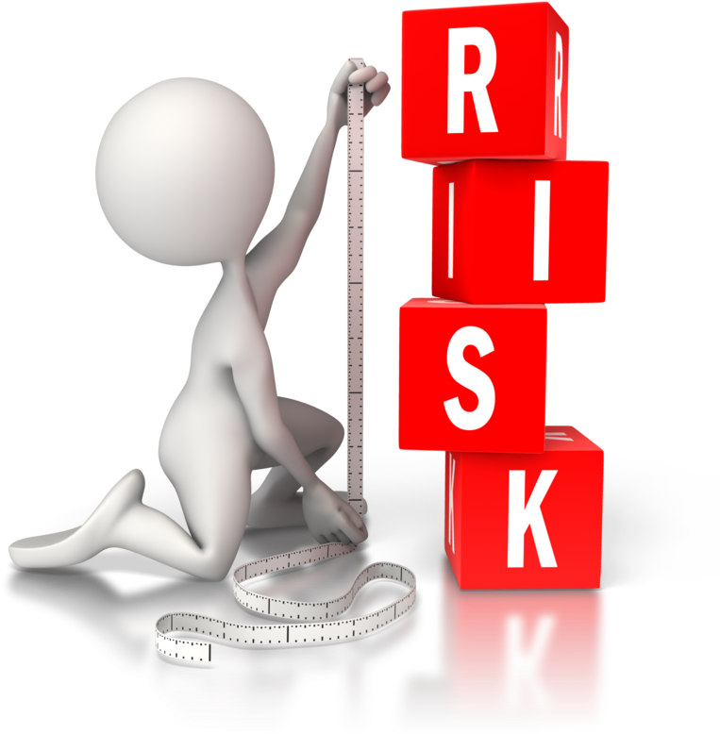
Risk Assessment
Assess the suitability of offering a Safety Agreement.
What key things should be considered in the Risk Assessment?
Who should be consulted?
Notes:
A risk assessment should be completed by a Church with a Person of Concern to assess the suitability of offering a Safety Agreement.
It does require extra effort by the Ministry Agent and Monitors, however this provides a safe community for the Person of Concern.
Using ‘Responding to a Person of Concern’:
1. What key things should be considered in the Risk Assessment?
2. Who should be consulted?
Work in groups of 2-4.
[Hint: Follow the steps in section 8]
[Answer:
Key things:
Is the Person of Concern willing to cooperate?
Can we keep people safe?
Do we have capacity to monitor a Person of Concern?
2. Who:
Person of Concern.
Synod legal, risk and insurance teams.
Church Council.
Ministry Agent.
Potential Monitors.]
Remember to keep matters confidential as outlined in section 15.

Slide 23
Identify Person of Concern (POC)
Complete Risk Assessment for POC
Recruit Monitors
Safety Agreement offered
POC to not attend Church
Accepted
Declined, withdrawn or not offered
Pastoral Care Provided
Maintain and Review
POC exits Church
Notes:
So far we have:
Identified a Person of Concern.
Church Council completed Risk Assessment.
Monitors recruited.
Now we will see what happens if a Safety Agreement is not offered or declined.

Slide 24
Safety Agreement NOT offered
Written decision communicated including consequences
Template (C2.4.1.3) on The Hub
Letter signed by:
General Secretary
Presbytery
Church Council
Pastoral Care will cease
Notes:
A Safety Agreement may not be offered if the risk cannot be managed appropriately. At this point in time:
Pastoral Care will cease.
Written decision communicated outlining the decision and consequences (such as not participating in a Church event nor being allowed on Church Property).
Letter signed by Church Council, Presbytery and General Secretary.
A Template and examples are available on the Hub.

Slide 25
Safety Agreement DECLINED
Not signed within specified period.
Terms of Safety Agreement not accepted.
Person of Concern has the right to:
Not consent to a Safety Agreement.
Withdraw at any time from the process.
Notes:
A Safety Agreement may be declined if:
Not signed within specified period.
Terms of Safety Agreement not accepted.
Additionally, the Person of Concern has the right to:
Not consent to a Safety Agreement.
Withdraw at any time from the process.
If a Safety Agreement is declined, similar to when a Safety Agreement is not offered, it must be specified in writing, and the person not allowed at Church events or on Church property.

Slide 26
Identify Person of Concern (POC)
Complete Risk Assessment for POC
Recruit Monitors
Safety Agreement offered
POC to not attend Church
Accepted
Declined, withdrawn or not offered
Pastoral Care Provided
Maintain and Review
POC exits Church
Notes:
Let’s look at what a Safety Agreement includes and the ongoing process.

Slide 27
Safety Agreement OFFERED
Agreement between 4 parties
Renewed and signed annually
Requires 2 Monitors in addition to Ministry Agent
Establishes terms and conditions
Notes:
A Safety Agreement:
Establishes terms and conditions for a Person of Concern to participate in the life of that Church while minimising the risk of harm to others.
It’s an agreement between 4 parties:
Person of Concern
Congregation or Faith Community
Presbytery, and
Synod
Requires a minimum of 2 Monitors, in addition to the Ministry Agent.
Renewed and re-signed annually.
Once offered, accepted and completely signed off, the Person of Concern can attend Church events with a monitor and within the terms and conditions outlined.

Slide 28
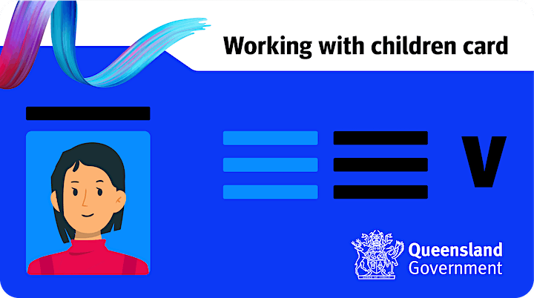
Scenario 2
C2.4.1.1
Notes:
Scenario 2
An activity leader's Blue Card was suspended due to updated police information.
The leader did not inform the church council.
A parent reported to the police that the leader had sexually touched their child, and the leader was charged with sexual offences.
The parent also made a complaint to the Church.
The Church Council offered a Safety Agreement, which the leader accepted.
[Question and overview on next slide]

Slide 29
Scenario 2 - Overview
Leader’s Blue Card suspended – updated police information
Leader did not inform the Church Council.
Parent reported (to police & Church): leader had sexually touched their child.
Leader was charged with sexual offences.
Safety Agreement offered and the leader accepted.
What 3 conditions should be included?
Notes:
For this scenario, What 3 conditions should be included in the ‘agreement and conditions’ section of a Safety Agreement?
Work in groups of 2-4 using ‘Responding to a Person of Concern’.
[Hint: use sections 11 and 12.]
Answer:
Some examples of conditions include:
Identifying which activities the POC will (or will not) be able to participate in.
Interaction with specific individuals and/or identified types (e.g. children).
Processes for monitoring the POC in a congregational setting.
Communication process.

Slide 30
Pause and Reflect
A POC Monitor supports and oversees the POC.
What qualities are needed in someone who is a Person of Concern Monitor?
Notes:
Let’s Pause and Reflect.
Having identified who a Person of Concern is and understanding inclusions within a Safety Agreement, a Monitor is a person who supports and oversees the Person of Concern, aiding in keeping our Church safe.
What qualities are needed in someone who is a Person of Concern monitor?
[Invite participants to share]
Hint: section 13
[Answer on next slide]

Slide 31
Person of Concern Monitor
Mature faith and person of integrity.
Current Safe Church training and Blue Card.
Mentorship, support and accountability for POC.
Meets, accompanies and shadows POC at Church events.
Understands the impact of grooming and sexual abuse and harm and reports actual or suspected actions to the police.
Identifies, interrupts and names behaviours that are a breach of the Safety Agreement and calmly and firmly advises the POC to leave.
Notes:
A Person of Concern Monitor should understand and fulfil their role including:
Possessing a mature faith and be a person of integrity
Maintaining current Safe Church training and Blue Card.
Providing mentorship, support and accountability for the Person of Concern.
Willingly meets, accompanies and shadows a Person of Concern at Church events.
Understands the impact of grooming and sexual abuse and harm and reports actual or suspected actions to the police.
Identifies, interrupts and names behaviours that are a breach of the Safety Agreement and calmly and firmly advises the Person of Concern to leave immediately.

Slide 32
Maintain and Review
Safety Agreements
Notes:
Once accepted, it is important to maintain and review Safety Agreements, which is the responsibility of the Church Council.

Slide 33
Maintaining Safety Agreements
Item | QUARTERLY reporting requirements
Pastoral Care sessions | Record dates
Events attended | What, when, where, monitor/s
Safety Agreement breaches | Breach occurred & action taken
Monitor compliance for training & Blue Cards | Date POC training completed & expiry date of Blue Card
Safety Agreement Review | ANNUALLY updated Safety Agreement
Notes:
Maintaining Safety Agreements includes ongoing provision for and quarterly reporting of the following:
Pastoral Care sessions (record dates).
Events attended (when, where and monitor/s present).
Safety Agreement breaches (breach and action taken).
Monitor compliance of training and Blue Cards (date completed/expiry).
The Safety Agreement is to be reviewed annually, considering:
Ability to manage risk.
Terms of the Safety Agreement.

Slide 34
Record Keeping
Safety Agreements (current and past).
Risk Assessment.
Safe Church Training and Blue Card record for:
Ministry Agent.
Church Council Chair.
Person of Concern Monitors.
Notes:
Records regarding each Person of Concern must be provided to Presbytery and Safe Church. These include:
Safety Agreements (current and past).
Risk Assessment for Person of Concern.
Safe Church Training details (including date, location and format) and Blue Card record for:
Ministry Agent.
Church Council Chair.
Person of Concern Monitors.

Slide 35
Breaches
Report immediately to General Secretary.
Complete internal and external reporting if needed.
POC not allowed at Church events or on Church property.
Investigation occurs as determined by General Secretary.
May result in a review, alteration or withdrawal of Safety Agreement.
Notes:
If there is a breach or alleged breach of the Safety Agreement:
Report immediately to General Secretary.
Complete internal and external reporting if needed, such as sexual abuse of a child which was not previously known by police.
Person of Concern not allowed at Church events or on Church property.
Investigation occurs by General Secretary or delegate who will determine if a breach occurred.
May result in a review, alteration or withdrawal of Safety Agreement.

Slide 36
Person of Concern ceases attending
Safety Agreement ceases.
Ministry Agent to notify General Secretary immediately.
General Secretary to communicate with:
Ministry Agent of new congregation (Uniting Church).
Denominational head (not Uniting Church).
Notes:
If the Person of Concern ceases attending the Congregation or Faith Community, the Ministry Agent must notify the General Secretary immediately.
If attending a new Church, the General Secretary will communicate with:
The Ministry Agent of the new congregation if within the Uniting Church.
The denominational head if not within the Uniting Church.

Slide 37
Quiz
Safe Church – Person of Concern
Notes:
Let’s have a look at a few questions related to this module.

Slide 38
Q1: A person who has criminal charges against them due to sexual offences against an adult starts to attend your Church. Are they a Person of Concern?
Yes.
No.
A
B
Notes:
Question 1: A person who has criminal charges against them due to sexual offences against an adult starts to attend your Church. Are they a Person of Concern?
Yes.
No.

Slide 39
Q1: A person who has criminal charges against them due to sexual offences against an adult starts to attend your Church. Are they a Person of Concern?
Yes.
No.
A
B
Notes:
Answer:
A: Yes.
Due to the criminal charges being sexual in nature, this meets the definition of a Person of Concern.

Slide 40
Q2: Should the presence of a Person of Concern be known by the entire Congregation or Faith Community?
Yes – for everyone’s safety.
No – some people may need to be informed due to their role, or as a mentor.
No – only the Church Council and Ministry Agent should know.
A
B
C
Notes:
Question 2: Should the presence of a Person of Concern be known by the entire Congregation or Faith Community?
Yes – for everyone’s safety.
No – some people may need to be informed due to their role, or as a mentor.
No – only the Church Council and Ministry Agent should know.

Slide 41
Q2: Should the presence of a Person of Concern be known by the entire Congregation or Faith Community?
Yes – for everyone’s safety.
No – some people may need to be informed due to their role, or as a mentor.
No – only the Church Council and Ministry Agent should know.
A
B
C
Notes:
Answer:
B: No – some people may need to be informed due to their role, or as a mentor.
This will include the Church Council, Ministry Agent, Person of Concern Mentor and may include specific ministry coordinators (such as the youth coordinator).

Slide 42
Q3: When would a Safety Agreement be declined, withdrawn or not offered?
Church Council not able to manage the risk involved.
Person of Concern not agreeing to Terms of Safety Agreement.
Annual Safety Agreement not signed within specified period.
All of the above.
A
B
C
D
Notes:
Question 3: When would a Safety Agreement be declined, withdrawn or not offered?
Church Council not able to manage the risk involved.
Person of Concern not agreeing to Terms of Safety Agreement.
Annual Safety Agreement not signed within specified period.
All of the above.

Slide 43
Q3: When would a Safety Agreement be declined, withdrawn or not offered?
Church Council not able to manage the risk involved.
Person of Concern not agreeing to Terms of Safety Agreement.
Annual Safety Agreement not signed within specified period.
All of the above.
A
B
C
D
Notes:
Answer:
D: All of the above.

Slide 44
Q4: Which is NOT a role requirement of a Person of Concern Monitor?
Accompanies a Person of Concern at Church events previously agreed upon.
Reports actual or suspected abuse or harm to the police.
Be available for all church events.
Provides mentorship, support and accountability for Person of Concern.
A
B
C
D
Notes:
Question 4: Which is NOT a role requirement of a Person of Concern Monitor?
Accompanies a Person of Concern at Church events previously agreed upon.
Reports actual or suspected abuse or harm to the police.
Be available for all church events.
Provides mentorship, support and accountability for Person of Concern.

Slide 45
Q4: Which is NOT a role requirement of a Person of Concern Monitor?
Accompanies a Person of Concern at Church events previously agreed upon.
Reports actual or suspected abuse or harm to the police.
Be available for all church events.
Provides mentorship, support and accountability for Person of Concern.
A
B
C
D
Notes:
Answer:
C: Be available for all church events.
Monitors and the Person of Concern must come to an agreement of which events will be attended by respective monitors. This ensures boundaries can be in place for the monitors and enables the Person of Concern to safely engage with the Church community.

Slide 46
Q5: How often is a Safety Agreement up for renewal?
Quarterly.
Every 6 months.
Annually.
Every 2 years.
A
B
C
D
Notes:
Question 5: How often is a Safety Agreement up for renewal?
Quarterly.
Every 6 months.
Annually.
Every 2 years.

Slide 47
Q5: How often is a Safety Agreement up for renewal?
Quarterly.
Every 6 months.
Annually.
Every 2 years.
A
B
C
D
Notes:
Answer:
C: Annually.
Safety Agreements should be re-signed each year. They may need to be reviewed within that time if pressing issues arise. It is reporting Pastoral Care sessions, events attended and any breaches that occurred which needs to occur quarterly.

Slide 48
Q6: A Person of Concern with a Safety Agreement leaves one Congregation to attend another Congregation. Should the Church Council inform the new congregation?
Yes – it’s the Church Council’s responsibility.
No – the Church Council has no responsibility after a POC leaves.
No – the General Secretary should be informed, and they will inform the new Congregation.
A
B
C
Notes:
Question 6: A Person of Concern with a Safety Agreement leaves one Congregation to attend another Congregation. Should the Church Council inform the new congregation?
Yes – it’s the Church Council’s responsibility.
No – the Church Council has no responsibility after a POC leaves.
No – the General Secretary should be informed, and they will inform the new Congregation.

Slide 49
Q6: A Person of Concern with a Safety Agreement leaves one Congregation to attend another Congregation. Should the Church Council inform the new congregation?
Yes – it’s the Church Council’s responsibility.
No – the Church Council has no responsibility after a POC leaves.
No – the General Secretary should be informed, and they will inform the new Congregation.
A
B
C
Notes:
Answer:
C: No – the General Secretary should be informed, and they will inform the new Congregation.

Slide 50
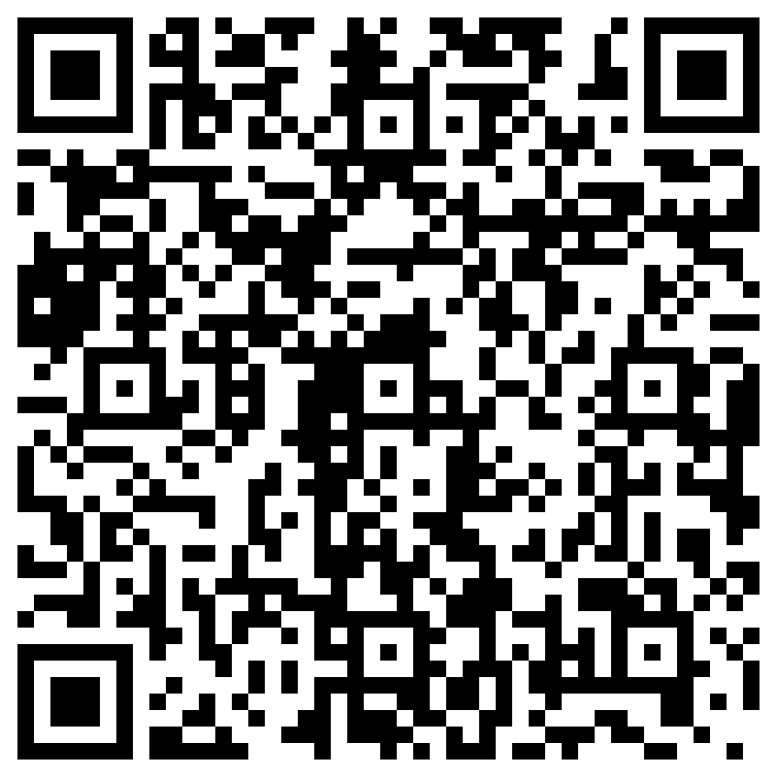
Ministry Agents
Only
Confirm you completed the module:
Scan the QR code.
Complete the form.
Notes:
To aid with record keeping, all Ministry Agents need to:
Scan the QR code.
Complete the form.
This will be accessible by your Presbytery to prove you have completed this module.

Slide 51
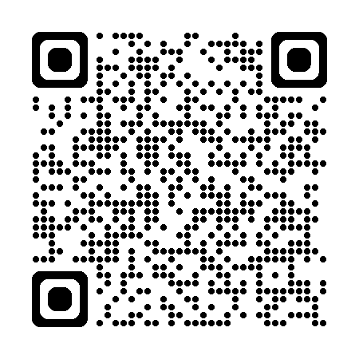
Thankyou!
Resources on The Hub:
hub.ucaqld.com.au
Contact Safe Church Unit:
safechurch@ucaqld.com.au
(07) 3377 9833
Notes:
Thank you so much for your time and effort with the training.
Safe Church resources can be found on The Hub.
Connect with the Safe Church Unit if you have any questions.

