Slide 1
Welcome to
Safe Church
Managing People & Records
Training
Notes:
Welcome to Safe Church – Managing People and Records Training.

Slide 2
Purpose
To gain an understanding of:
Requirements for registers and records.
The selection, screening and approval process for volunteers and workers.
How to support people in their roles.
The process for responding to and addressing unacceptable behaviour.
Notes:
The purpose of this module is for you to gain an understanding of:
Requirements for registers and records.
The selection, screening and approval process for volunteers and workers.
How to support people in their roles.
The process for responding to and addressing unacceptable behaviour.
General Information:
Thank you for the time and effort you already put into administration and caring for people.
We recognise you are likely doing these things (it may look a little different).
There might be one or two things you can start doing.
This module confirms some aspects that may have been unclear in the past.
Please ensure you reach out to the Safe Church team if you do have questions.

Slide 3
SAFE PROGRAMS
SAFE PARTICIPANTS
SAFE BEHAVIOUR
Safe Church
SAFE PEOPLE
Notes:
This module focuses on Safe People and Safe Behaviour.

Slide 4
WARNING
Information may be unsettling, challenging, confronting or distressing.
It is important you are safe and seek support from someone you trust.
Notes:
WARNING
Information includes talk of abuse, neglect and grooming.
It may be unsettling, challenging, confronting or distressing.
It may trigger memories, cause flashbacks or remind you of events you or others have experienced.
It is important you are safe and seek support from someone you trust.

Slide 5
QLD Legislation – 8 Minimum Requirements
1. Statement of Commitment
5. A plan for managing breaches of risk management strategy
2. Code of Conduct
6. Risk management plans for high-risk activities & special events
3. Written procedures for volunteers: selecting, training, managing volunteers
7. Policies and procedures for managing Blue Card compliance
4. Policies and procedures on disclosures & reporting abuse etc
8. Strategies for communication and support
Notes:
8 minimum requirements from Queensland and national legislation are outlined.
Targeted towards working with Children – Safe Church policy extends this to all attendees.
What we ask of you (and volunteers) is aligned with these requirements.

Slide 6
Managing
Registers and Records
Notes:
Maintaining registers and records helps protect the safety and wellbeing of everyone.
Ensures compliance with legislative requirements.

Slide 7
Event Records & Forms
Kept confidential and secure
Forms on the Hub or digital equivalent
Keep for 70 years any records related to young people
Notes:
Event records may include:
Attendance records – list of all attendees at an event.
Image release forms – connected to a person (rather than a specific event).
Attendee information forms – child-related events.
Form templates available on the Hub, or a digital equivalent can be created on UCare or Microsoft forms etc.
Kept confidential and secure in digital or paper format.
E.g. if you scan a paper form and store digitally, the paper copy can be destroyed.
Digital formats – recommend a secure cloud, or a secure back up system (in case a computer crashes).
Keep for 70 years any records related to young people.

Slide 8
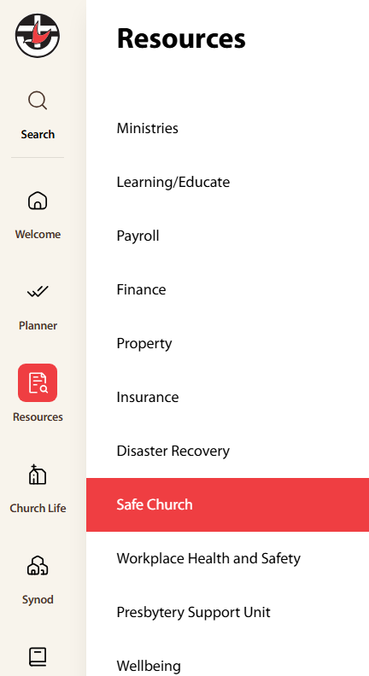
Uniting Church in Queensland
The Hub
C2.1.11
hub.ucaqld.com.au
Notes:
A quick reminder about how you can access resources on The Hub.

Slide 9
Register of Workers & Volunteers (ALL)
Name
Role
DOB
Blue Card type, expiry, number [if role requires]
Application process dates
Training dates
SOPC dates
Exit Date
Unlink Blue Card
Notes:
A Register of Workers and Volunteers includes information regarding ALL volunteers and workers, regardless of whether:
They need a Blue Card.
They work with young or vulnerable people.
This ensures key legislative requirements are met.
It should be kept securely and updated regularly.
A template is available on the Hub
Equivalent versions can be created on UCare or other Church Management Software.

Slide 10
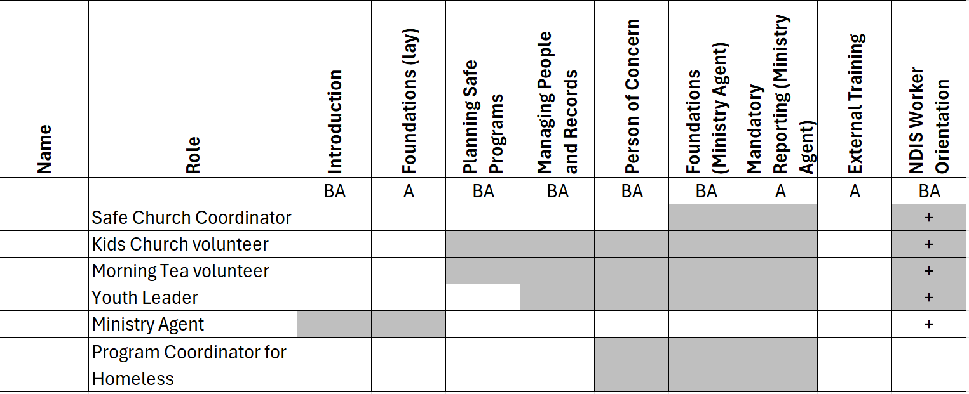
Managing Safe Church Training Compliance
Church Council responsibility (lay)
Flexible methods.
PresbyterySupportUnit@ucaqld.com.au
Module confirmation:
Training register.
Email from facilitator.
Email confirmation of passing the online quiz.
Notes:
Let’s have a look at responsibilities regarding Safe Church training.
Completing training – responsibility of the individual volunteer/worker.
Managing compliance – responsibility of:
Church Council (or delegate) for Lay people
Presbytery for Ministry Agents.
Methods of monitoring compliance:
Flexible - best to align with Register of Workers where possible.
Excel – create columns for each course, shade courses not needed and add dates when training is complete. Template available on the Hub, which can be copied into existing document.
UCare – forms or processes to capture training attendance/completion.
From 2025, certificates are phased out. Acceptable confirmation includes:
Copy of in-person training register.
Email from Facilitator (with list of names and modules completed).
Email confirmation of passing the online quiz – shown/forwarded by individual.

Slide 11
Recognition of Prior Learning (C2.1.6)
For individuals whose occupation mandates equivalent training (Teacher, Childcare, Police Officer etc).
Complete form (C2.1.6.1), include proof and email Safe Church.
Notes:
Recognition of Prior Learning
For individuals whose occupation mandates equivalent training (e.g. teacher, childcare, police officer etc).
Can apply for recognition of Prior Learning for some modules.
Complete the form, include proof and email Safe Church for approval.
Show/forward confirmation to Church.

Slide 12
External Training (C2.1.11.13.1)
1 hour completed annually by all volunteers/workers.
Recommendations on the Hub or in Uniting News.
If aligns with a topic below, training is acceptable.
Safeguarding children & young people Safeguarding vulnerable people Abuse, harm and neglect Domestic violence CPR - First aid Child Behaviour Management | Child Development Equity and Diversity training Bullying and Harassment training Workplace Health and Safety Relationship Building Team Building
Notes:
External Training
1 hour completed annually by all volunteers/workers.
Aim: Be further equipped with information and skills in safeguarding, and meet requirements from insurer (since late 2024).
Recommendations on the Hub or in Uniting News.
Optional in 2025 due to transition period and compulsory from 2026 onwards.
Approval process
Individual completes a course or watches recommended video and shows/informs Church.
Church accepts courses that align with the listed topics.
If unsure if a topic aligns, email Safe Church with course title and details for confirmation.
Church records date and course title.
[Note: this can be done as a group, with a training register used as confirmation of those who completed the course]

Slide 13
Safe Church Audit Documents
Minutes or template (C2.1.13.3) adopting Safe Church Policy.
List of child-related activities.
Register of Workers/Volunteers and Blue Card register.
Statement of Commitment (scan) & SOPC (list of names)
Risk assessment of one activity.
Breach register (C2.1.15) – internal actions to resolve.
Notes:
For the annual Safe Church Audit, there are a number of documents that are needed, including:
Minutes or template adopting the Safe Church policy.
A list of child-related activities.
Register of workers and volunteers (and a Blue Card register if this is not already included).
Statement of Commitment – Ministry Agents (scanned/digital copy) and Statement of Personal Commitment – Lay (list of names, likely in Register of Workers).
Risk assessment of ONE activity.
Breach register.
Used when an individual is not compliant with part of the Safe Church policy.
Encourages internal reporting and actions taken to resolve (e.g. training module completed or Statement of Personal Commitment re-signed).
Aim to keep everyone safe.
Church Council to maintain and review the register periodically.

Slide 14
Hazard/Incident Register
Includes all known or reported incidents.
Updated as hazards and incidents are resolved.
Reviewed regularly by Church Council.
Retained indefinitely.
Notes:
Congregations must retain a hazard and incident register which can be reported and recorded in the program called Protecht, which each Congregation can access. This register must:
Include all known or reported incidents. If an incident was reported through the ‘Speak Up!’ QR code or link, this will automatically be added for you.
Be updated as hazards and incidents are decreased or resolved.
Be reviewed regularly by Church Council.
Be retained indefinitely.

Slide 15
Keep Indefinitely | Keep Indefinitely
Accidents Incidents Hazards | Concerns, allegations or knowledge of abuse (including grooming)
70 Years | Varies (H2.1.3)
Child-related activities (attendee forms, volunteer application documents, Blue Card notices, Register of Volunteers etc.) | Historical Records Church Closure
Notes:
Information that is collected and stored must be done so in accordance with the Synod Privacy Policy and kept in a secured location in paper or digital formats.
Keep indefinitely when related to:
Accidents, incidents or hazards.
Concerns, allegations or knowledge of abuse (including grooming).
Keep for 70 years any child-related documents (attendee forms, volunteer application documents, Blue Card notices, Register of Volunteers etc.)
The length of time varies for other Historical Records, and what must be kept if a Church closes.
Details regarding long-term digital storage is in document H2.1.3.
If your Church has not kept these documents for the respective lengths, please start doing this from now on.

Slide 16
Pause and Reflect
For your processes of managing registers and records:
What works well?
What could be changed?
Notes:
Let’s pause and reflect.
For your processes of managing registers and records:
What works well?
What could be changed?
Take 2 minutes to share with the person next to you.
[Optional to take a short break before going into the next section]

Slide 17
Worker & Volunteer
Selection, Screening &
Approval Process
C2.1.2 Managing People Procedure
Notes:
The selection, screening and approval process is to:
Select people who will positively contribute to our Safe Church culture.
Actively exclude people who may harm or abuse people.
Required by all applicants – volunteer and paid.
Ensures compliance with legislation (most volunteer organisations have a similar process).
Church Council holds responsibility for applicants to be screened and trained.

Slide 18
Process for New Volunteers
Steps | Resources on the Hub
1. Application Submitted | C2.1.2.15
2. Interview & Referee Check | C2.1.2.16 & C2.1.2.4
3. Blue/Exemption Card Check | C2.1.10.3
4. Church Council Approval & Appointment | C2.1.2.1 & C2.1.2.5
5. Applicant Acceptance & Statement of Personal Commitment Signed | C2.1.2.7
6. Blue/Exemption Card Linked | C2.1.13.5
7. Safe Church Training | C2.1.11
8. Document Retention | C2.1.13.6
9. Applicant Commences Role | C2.1.2.8 & C2.1.2.9
Notes:
The process for new volunteers helps to:
Screen their interest and skills.
Attain internal and external approval.
Build a Safe Church culture aligned with legislative requirements to protect and support people, especially those who are young or vulnerable.
Some steps may occur at the same time, such as waiting for a Blue Card.
[Optional example: Does this apply to someone who has been at my Church for the last 10 years, and just wants to help by serving morning tea? Yes. We love people’s willingness to serve, and this process provides a chance for more formal conversations to be had and generally confirm your instincts that this person is a suitable fit for the role.]

Slide 19
# Step
Register of Workers & Volunteers
Best practice – recommended process
Alternative process– still meets requirements
hub.ucaqld.com.au
C2.1.2
Notes:
A quick overview about the next few slides:
Double tick – ‘Best practice’ – recommended process.
Single tick – ‘Alternative process’ – meets requirements in a more relational approach.
Type number codes into the search function on the Hub.
The red box at the top right identifies items to add to the Register of Workers/Volunteers.
Details in the handout for easy reference after the training.

Slide 20
1. Application Submitted
Full Name, Date of Birth, Role
‘Volunteer Application Form’ (C2.1.2.15) including declaration completed.
Notes:
Step 1.
Any person wishing to volunteer within the Church is required to complete an application.
This begins the process of determining the applicant’s gifts and talents and general suitability for the role.
✓✓ Best practice is for the ‘volunteer application form’ including declaration to be completed. The declaration includes questions around privacy, suitability and potential historic discipline received or actions regarding abuse or neglect of young or vulnerable people.

Slide 21
1. Application Submitted
Full Name, Date of Birth, Role
‘Volunteer Application Form’ (C2.1.2.15) including declaration completed.
Conversation with Applicant.
Notes:
✓ Alternatively, this could be a conversation asking about their interest in the role, previous experiences, or issues impacting their ability to volunteer or where required, gain a Blue Card.

Slide 22
2. Interview & Referee Check
Interview Date | Referee Check Date
Interview applicant, record notes on form (C2.1.2.16).
Contact 2 referees (optional guidance on C2.1.2.4).
Notes:
Step 2.
The interview and referee check helps you to gain further insights into whether a person has the relevant skills, abilities or qualifications and suitability.
✓✓ -Best practice is to interview the applicant and record notes on the ‘Volunteer record of interview’ form.
-Contact 2 referees and if you are not sure what to ask them, there are optional guiding questions available.

Slide 23
2. Interview & Referee Check
Interview Date | Referee Check Date
Interview applicant, record notes on form (C2.1.2.16).
Contact 2 referees (optional guidance on C2.1.2.4).
Informal conversation, record notes/outcome.
Contact 2 referees.
Notes:
✓-Alternatively, have an informal conversation with the applicant and records notes or outcome – whether the applicant is suitable or not.
-Contact 2 referees.
By having a systematic screening process, you increase the likelihood of detecting a person that is likely to cause harm.
However, this approach relies on the ability of the person conducting the process to pick up on ‘red flags’ during the screening process.
[Continued next slide]

Slide 24
RED FLAGS
Indicating they have been responsible for harm in the past. | Gap in work history. | Motivation to work with children to fulfil own self-interests.
Inability to provide reference from most recent workplace. | Inappropriate ideas for responding to behaviour. | Inconsistencies between referee and applicant information.
Notes:
A ‘red flag’ is an indicator that there is cause for concern about the applicant, however it is not necessarily an automatic disqualifier.
It means additional scrutiny is required before deciding a person’s suitability.
If red flags are not able to be satisfactorily explained, it is highly likely the applicant is not able to be assessed as being ‘suitable.’
Some examples of a red flag could include:
An applicant indicating they have been responsible for harm to a young or vulnerable person in the past.
A gap in their work history.
Motivation to work with children to fulfill own self-interests and desires.
An inability to provide a reference from their most recent workplace.
Inappropriate ideas and approaches to responding to behaviour of young or vulnerable people.
Inconsistencies between referee and applicant information.

Slide 25
3. Blue Card / Exemption Card Check
Role, If Blue Card required, Card Details/application date
Apply for Blue/Exemption Card if required by role.
Check validity of card details (C2.1.10.3) online.
Valid |  | Cannot be validated
No additional steps yet |  | Inform applicant
Notes:
Step 3.
If a role requires a Blue or Exemption card, and the applicant does not already possess one, they should apply for the relevant card themselves using the digital or paper form.
If the applicant already possess a card, check the validity of it online. [There is no ✓ alternative]
The process will return one of two outcomes:
The card number is a valid card – no additional steps occur yet.
The card details provided cannot be validated. If this occurs, inform the applicant and advise them to contact Blue Card Services. It could be due to incorrect spelling, the wrong card number or expiry date, or the applicant’s positive notice may have been cancelled or suspended.
If the applicant advises, or if it becomes known that their Blue or Exemption card has been cancelled, the applicant is not appropriate to work with young or vulnerable people.

Slide 26
4. Church Council Approval & Appointment
CC Approval Date
CC reviews Application, Interview and Referee checks.
CC decision, noted in minutes.
Approved |  | Not Approved
Letter of Appointment outlining role (C2.1.2.5 & C2.1.2.1) Statement of Personal Commitment (C2.1.2.7) |  | Advised in an appropriate and sensitive way (discussion). Written response.
Notes:
Step 4.
Once the suitability screening is complete, the Church Council is responsible for approving the applicant’s appointment.
✓✓ -Best practice is for the Church Council to review the application, interview and referee checks. -The Church Council makes a decision, and the outcome is noted in the meeting minutes.
If approved, the applicant is provided with:
Letter of Appointment which clearly outlines the role and ongoing training requirements. Alternatively, the role is verbally outlined.
Statement of Personal Commitment.
If not approved, ensure the applicant:
Is advised in an appropriate and sensitive way, such as in a discussion.
Receives a written response, if appropriate.
[There is no ✓ alternative]

Slide 27
5. Applicant Acceptance & SOPC Signed
Date/year SOPC Signed
Letter of Appointment reviewed and role accepted.
Statement of Personal Commitment signed.
Role accepted.
Statement of Personal Commitment signed.
Notes:
Step 5.
Applicant’s response to offer.
✓✓ -Best practice is the Letter of Appointment is reviewed by applicant and the role is accepted in a written or verbal manner.
- Statement of Personal Commitment is signed.
✓ - Alternatively, the role is accepted, potentially with previous conversation and the Statement of Personal Commitment is signed.
It is important that volunteers understand what is expected of them – in their roles and their actions. By signing, the person acknowledges their commitment to fostering a Safe Church culture and take responsibility for their own behaviour.
The Statement of Personal Commitment MUST be signed before they commence their role, and re-signed annually reflecting their ongoing commitment.
[Continued next slide]

Slide 28
Behaviours
C2.1.2.7.1 – List of Acceptable Behaviours
C2.1.2.7.2 – List of Unacceptable Behaviours
Physical | Emotional
Behavioural | Spiritual
Notes:
Please ensure applicants are also aware of the List of Acceptable Behaviours, and the List of Unacceptable Behaviours, ensuring they have a full understanding of the physical, emotional, behavioural and spiritual boundaries we expect of them.
People may have legitimate resistance to signing the Statement of Personal Commitment. If so, their suitability to volunteer is called in to question and if not resolved, the person will be unable to volunteer for the Church.

Slide 29
6. Blue Card / Exemption Card Linked
Card Details (type, number, expiry, if linked)
If role requires a Blue/Exemption Card:
Record card details.
Link card to Congregation/Faith Community using:
Blue Card Organisation Portal.
Form.
Applicant cannot commence until card is linked.
Notes:
Step 6.
If the applicant required a Blue or Exemption card for their role, and has possession of it:
Record the card details (full name, card number, card type and expiry date) on the Register of Workers, or within the Blue Card portal.
Link the card to the Congregation or Faith Community using:
Blue Card Organisation Portal, or
A form, and wait for confirmation that it has been processed.
If a Card is required for the role, the applicant cannot commence until the card is linked.
[There is no ✓ alternative]

Slide 30
7. Safe Church Training
Training completion date/year for each module
Applicant completes Safe Church training modules required for role (matrix: C2.1.11):
In-person.
Online (using video and quiz resources on the Hub).
Notes:
Step 7.
To help the applicant understand the Safe Church culture, they must complete the Safe Church training modules required for their role as outlined in the matrix. This training can be completed in person at the next training session, or online using the video and quiz resources on the Hub.

Slide 31
8. Document Retention
Note: Exit date/unlink Blue card when role concludes
Update Register of Workers during application process.
Store documents securely and confidentially.
Notes:
Step 8.
Document retention is important for legislative requirements.
✓✓ -Best practice is to update the Register of Workers during the application process.
- Store documents securely and confidentially. A reminder that child-related documents such as Blue Card notices must be retained for 70 years.

Slide 32
9. Applicant Commences Role
Confirm with applicant that all steps are complete, and they can volunteer in this role.
Ongoing support provided (C2.1.2.8 & C2.1.2.9).
Notes:
Step 9.
Once all training is complete, the Statement of Personal Commitment is signed and if applicable Blue card linked, you can let the applicant know that all steps are complete, and they can begin volunteering in this role.
Ongoing support should be provided, which is outlined in the next section.

Slide 33
Pause & Reflect
For the selection, screening and approval process:
What are the benefits?
What are some challenges?
What changes could be made to your current process?
Notes:
Let’s pause and reflect.
Consider: for the selection, screening and approval process:
What are the benefits?
What are some challenges?
What changes (if any) could be made to your current process?
Take 2 minutes to share with the person next to you one benefit, one challenge and one change.
[Optional to take a short break before going into the next section]

Slide 34
Supporting People
in their Roles
Notes:
People who feel supported and valued in their roles are more likely to contribute to a culture of shared guardianship because they:
Understand what is expected of them.
Are in roles that suit their abilities.
Contribute to our culture positively through values, attitudes and conduct.
Can recognise and respond well when something is concerning or reportable.
By actively monitoring, supporting and engaging with volunteers, together we continue to strengthen the desired culture.

Slide 35
Process for All Volunteers
 | Resources on the Hub
New Starter Check-in | C2.1.2.8
Annual Wellbeing Check-in | C2.1.2.9
Regular Recognition
Addressing Unacceptable Behaviours
 | Resources on the Hub
Corrective Action | C2.1.3 & C2.1.2.12
Performance Improvement Process | C2.1.9
Reporting Obligations | C2.1.5.3 (MA) & C2.1.5.5
Notes:
This is an overview of the ongoing process for all volunteers where we emphasise the importance of:
New Starter Check-in for new volunteers or those who are starting new roles.
Annual Well-being Check-in.
Regular Recognition.
It is also important to know the resources and strategies available when addressing unacceptable behaviours through:
Corrective Action.
The Performance Improvement Process.
Reporting Obligations.

Slide 36
Ongoing
Volunteer Process
Notes:
We will first look at the ongoing volunteer process.

Slide 37
New Starter Check-In
Formal check-in 4-6 weeks after starting new role, noting responses to key questions (C2.1.2.8).
Conversation 4-6 weeks after starting new role.
Notes:
The New Starter Check-in provides an opportunity to have a two-way conversation with a new volunteer to review:
If they feel welcomed.
Their connections with their team.
If they know what is expected in their role.
Information or support they may need.
This is one way we can care about the wellbeing of volunteers and check to see how they are settling into their role.
✓✓ Best practice is a formal check-in 4-6 weeks after starting new role, noting responses to key questions in the form.
✓ Alternatively, have an intentional conversation with the new volunteer.

Slide 38
Annual Wellbeing Check-in
Notes:
The Annual wellbeing check-in and feedback process is intended as a two-way conversation, intentionally seek insights into:
The wellbeing of volunteers.
If volunteers are fulfilling their potential, or if there are opportunities for growth.
Questions or concerns volunteers may have.
Volunteers’ understanding of the Church’s mission and values, acceptable behaviours, and their part in fostering a Safe Church culture.
It also provides an opportunity for a leader to provide and receive feedback with a volunteer in their team.
[Continued next slide]

Slide 39
Annual Wellbeing Check-in
Formal (C2.1.2.9) or informal.
Individual or group.
Gain feedback about their experiences - positive and negative.
Create a shared plan for the next 12 months.
Notes:
It can be formal (with guiding questions) or informal.
Individual (such as a leader checking in with each member of their team) or a wider group. Some churches hold a special morning tea, celebration during volunteer’s week, or catch up at the beginning of each year.
It’s a chance to gain feedback about their experiences – positive and negative.
You might like to take the time to create a shared plan for the next 12 months, including aspirations or improvements.

Slide 40
Regular Recognition
Provide regular, authentic recognition and appreciation.
Before or after events | Identify specific, positive contributions
Identify character traits | Note or message of thanks
Who is someone you could thank?
Notes:
It’s important to recognise the ongoing work that people do, affirming their significance as a person as well as their contribution to the Church’s ministry.
We encourage you to provide regular, authentic recognition and appreciation such as:
Before or after events (in a way that does not become routine).
Identify specific, positive contributions a person made.
Identify character traits that you appreciate.
A note or message of thanks.
There are many ways volunteers can be appreciated, especially if we are intentional and specific.
Consider for a moment – Who is someone you could thank?

Slide 41
Addressing
Unacceptable Behaviours
Notes:
A key component of managing people is the responsibility to address Unacceptable Behaviours.

Slide 42
Performance Improvement Process
Actions include (C2.1.9):
Performance management discussions.
Written warnings.
Final warnings.
Demotion or changes of duties.
Suspension from duties.
Notes:
The Performance Improvement Process outlines key actions required when dealing with a range of potential situations, from complaints or concerns to incidents or allegations, ensuring responses are appropriate and fair.
Actions include:
Performance management discussions.
Written warnings.
Final warnings.
Demotion or change of duties, and
Suspension from duties.
[The Performance improvement process should help people to think about their actions and behaviour. Sometimes it is important that people are freed to use their gifts and skills elsewhere.]
[Continued next slide]

Slide 43
Performance Improvement Process
Crucial steps not missed | Appropriate evidence gathered
Offer principles of natural justice and procedural fairness | Avoid breaches of standards or expectations
Notes:
This process of responding should be used in conjunction with the Mandatory Reporting processes, which outline reporting obligations. This ensures that:
Crucial steps are not missed.
Appropriate evidence is gathered.
The person is offered the principles of natural justice and procedural fairness.
The person overseeing the process does not breach any standards or expectations throughout the process.
For support with these actions, speak to the People and Culture team at the Synod Office.

Slide 44
Reporting Obligations
Report abuse, harm or neglect (or suspicions) (C2.1.5.5).
Internal and external reporting may occur simultaneously. (Internal investigations may be delayed until permitted by police)
Follow Mandatory Reporting processes. Ministry Agents (C2.1.5.3) | Lay (C2.1.2.12)
Failing to report a reasonable suspicion of harm is a breach of the Safe Church policy and violation of the SOPC.
Notes:
For reporting obligations, ensure:
Suspicions of or actual abuse, harm, neglect, boundary violations, misconduct, grooming or other behaviour that may place a young or vulnerable person at risk of harm is reported.
Internal reporting should NEVER inhibit or delay reporting required matters, externally, such as to police. In cases where a criminal offence has or may have occurred, the matter should be reported to police immediately and internal investigations and processes should not commence until police advise those processes may begin or continue.
Follow Mandatory Reporting processes which outline how and to whom reports should be made.
Failing to make a report about a reasonable suspicion of harm is a breach of the Safe Church policy and a violation of the Statement of Personal Commitment. This failure also takes away from the Church’s culture of shared guardianship and fails the care and protection that people need.

Slide 45
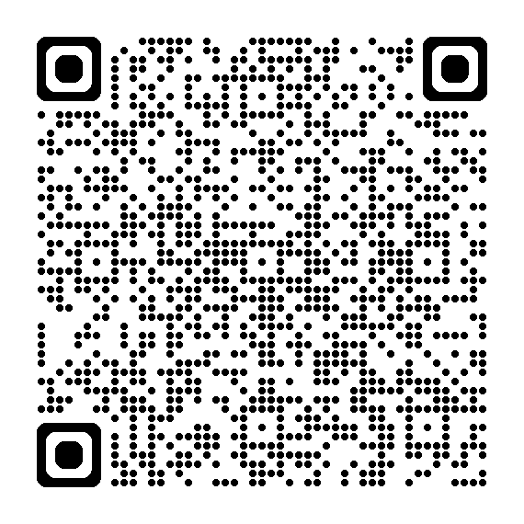
Scan to report a concern or incident of:
Notes:
A reminder to speak up! Safety is everybody’s responsibility. Please report injury, illness, abuse, neglect, boundary violations, hazards, near misses and property damage through the QR code or link on the hub.

Slide 46
Pause & Reflect
For potential criminal offences, “internal investigations and processes should not commence until police have advised that those processes may begin or continue”.
Why is it important to wait for the approval from police before undertaking the internal investigations and processes?
Notes:
Let’s pause and reflect.
We have just heard that for potential criminal offences, “internal investigations and processes should not commence until police have advised that those processes may begin or continue.”
Spend a few minutes brainstorming your response to the question:
Why is it important to wait for the approval from police before undertaking the internal investigations and processes?
[Answers could include:
Evidence is not destroyed or tampered with.
Police investigation (or witnesses) not influenced by questioning from internal processes.
If taken to court, it ensures no bias from any witnesses.
Respect for the role and experience of Police to complete required tasks without delay.]

Slide 47
Corrective Action
Address issues promptly.
Responding to Complaints and Concerns (C2.1.3)
Evaluate relevant information.
Enact on or report concerns (C2.1.2.12)
Responding to boundary violations | Managing performance issues | Termination process
Notes:
Corrective action is the response by supervisors when conduct issues or concerns must be addressed.
Consider if the volunteer is still suitable for their role.
Performance issues may be:
A specific issue.
A number of minor issues that have been observed or reported.
Seemingly unrelated performance issues.
Address issues promptly according to the ‘Responding to Complaints and Concerns’ process which outlines:
Responding to boundary violations.
Managing performance issues.
Termination processes.
It is important to:
Evaluate relevant information.
Enact on or report concerns as required, especially when performance, conduct or behaviour place a person at risk of harm or has caused harm.

Slide 48
Quiz
Safe Church
Managing People & Records
Notes:
Let’s have a look at a few questions related to this module.

Slide 49
Q1: Any document related child-related activities should be kept:
For 2 years.
For 70 years.
Until they cease volunteering.
Until 7 years after they left the Congregation.
A
B
C
D
Notes:
Question 1: Any document related to child-related activities should be kept:
For 2 years.
For 70 years.
Until they cease volunteering.
Until 7 years after they left the Congregation.

Slide 50
Q1: Any document related child-related activities should be kept:
For 2 years.
For 70 years.
Until they cease volunteering.
Until 7 years after they left the Congregation.
A
B
C
D
Notes:
Answer:
B. For 70 years
Due to legislative requirements surrounding children, documents related to child-related activities or leaders including event attendance, attendee information, volunteer application process and ongoing training must be retained for 70 years.

Slide 51
Q2: A ‘red flag’ indicates a cause for concern about the applicant, but it is not always a disqualifier for volunteering. Which of the following is a ‘red flag’?
Excellent skills and experience in the relevant field.
Positive statements from their referees.
Enjoys working with young people.
Motivation to work with children is to fulfill own self-interests.
A
B
C
D
Notes:
Question 2: A ‘red flag’ indicates a cause for concern about the applicant, but it is not always a disqualifier for volunteering. Which of the following is a ‘red flag’?
Excellent skills and experience in the relevant field.
Positive statements from their referees.
Enjoys working with young people.
Motivation to work with children is to fulfill own self-interests.

Slide 52
Q2: A ‘red flag’ indicates a cause for concern about the applicant, but it is not always a disqualifier for volunteering. Which of the following is a ‘red flag’?
Excellent skills and experience in the relevant field.
Positive statements from their referees.
Enjoys working with young people.
Motivation to work with children is to fulfill own self-interests.
A
B
C
D
Notes:
Answer:
D. Motivation to work with children is to fulfill own self-interests.
Any concerning motivations should be unpacked further to ensure no risk of harm towards children.

Slide 53
Q3: Who must be added to the Register of Workers?
Only volunteers/workers in ministries with young or vulnerable people.
Each Church Council can choose who is added.
All volunteers/workers, regardless of their role.
A
B
C
Notes:
Question 3: Who must be added to the Register of Workers?
Only volunteers/workers in ministries with young or vulnerable people.
Each Church Council can choose who is added.
All volunteers/workers, regardless of their role.

Slide 54
Q3: Who must be added to the Register of Workers?
Only volunteers/workers in ministries with young or vulnerable people.
Each Church Council can choose who is added.
All volunteers/workers, regardless of their role.
A
B
C
Notes:
Answer:
C. All volunteers/workers, regardless of their role.

Slide 55
Q4: The annual well-being review is a time to:
Only discuss common interests and hobbies.
Discuss feedback as a two-way conversation.
Only inform volunteers about their poor performance.
A
B
C
Notes:
Question 4: The annual well-being review is a time to:
Only discuss common interests and hobbies.
Discuss feedback as a two-way conversation.
Only inform volunteers about their poor performance.

Slide 56
Q4: The annual well-being review is a time to:
Only discuss common interests and hobbies.
Discuss feedback as a two-way conversation.
Only inform volunteers about their poor performance.
A
B
C
Notes:
Answer:
B. Discuss feedback as a two-way conversation.

Slide 57
Q5: You check the validity of a Blue/Exemption Card of a new volunteer, and it returns the result ‘the card details cannot be validated’. Does this mean the applicant will never be able to work with children?
Yes
No
A
B
Notes:
Question 5: You check the validity of a Blue/Exemption Card of a new volunteer, and it returns the result ‘the card details cannot be validated’. Does this mean the applicant will never be able to work with children?
Yes.
No.

Slide 58
Q5: You check the validity of a Blue/Exemption Card of a new volunteer, and it returns the result ‘the card details cannot be validated’. Does this mean the applicant will never be able to work with children?
Yes
No
A
B
Notes:
Answer:
B. No
Details not validated may mean an incorrect name spelling or date of birth, or the card has expired. This is different from a negative Blue Card notice, which needs further investigation.

Slide 59
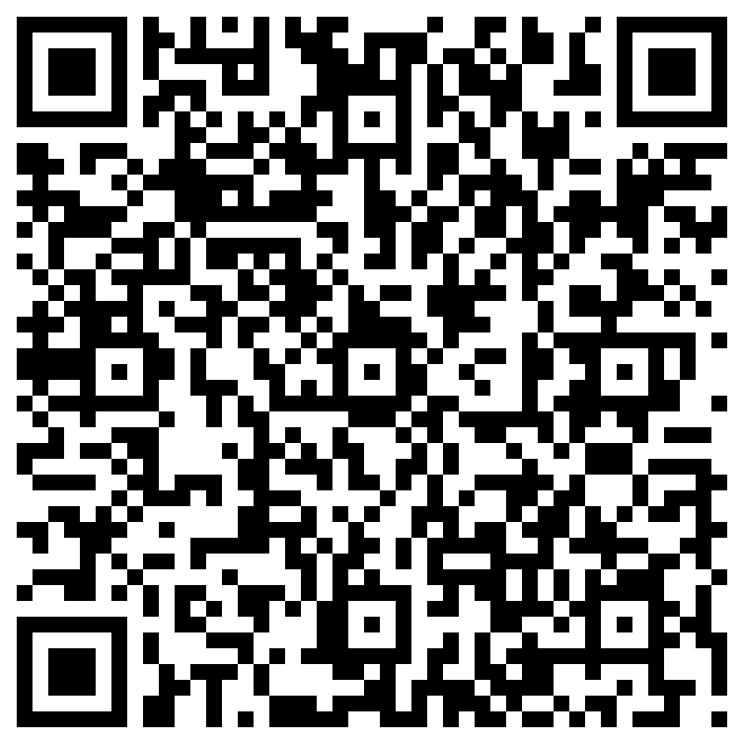
Ministry Agents
Only
Confirm you completed the module:
Scan the QR code.
Complete the form.
Notes:
To aid with record keeping, all Ministry Agents need to:
Scan the QR code.
Complete the form.
This will be accessible by your Presbytery to prove you have completed this module.

Slide 60
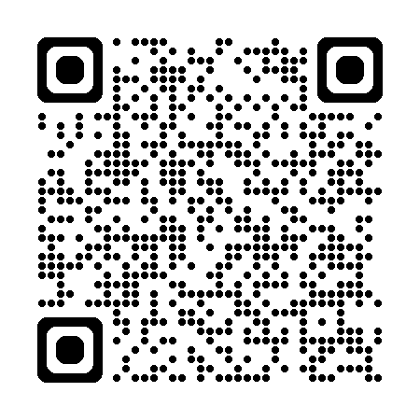
Thankyou!
Resources on The Hub:
hub.ucaqld.com.au
Contact Safe Church Unit:
safechurch@ucaqld.com.au
(07) 3377 9833
Notes:
Thank you so much for your time and effort with the training.
Safe Church resources can be found on The Hub.
Connect with the Safe Church Unit if you have any questions.

