Slide 1
Welcome to
Safe Church
Foundations (Lay)
Training
Notes:
Welcome to Safe Church – Foundations Training.

Slide 2
Purpose
To gain an understanding of:
The definitions of child abuse and neglect.
Recognising indicators of abuse, neglect and boundary violations.
Responding to unacceptable behaviours.
Notes:
The purpose of this training is to gain an understanding of:
The definitions of child abuse and neglect.
Recognising indicators of abuse, neglect and boundary violations.
Responding to unacceptable behaviours.

Slide 3
SAFE PROGRAMS
SAFE PARTICIPANTS
SAFE BEHAVIOUR
Safe Church
SAFE PEOPLE
Notes:
This module focuses on Safe People, Safe Behaviour and Safe Participants.

Slide 4
WARNING
Information may be unsettling, challenging, confronting or distressing.
It is important you are safe and seek support from someone you trust.
Notes:
WARNING
Information includes descriptions of abuse, neglect and grooming.
It may be unsettling, challenging, confronting or distressing.
It may trigger memories, cause flashbacks or remind you of events you or others have experienced.
It is important you are safe and seek support from someone you trust.

Slide 5
Historical context of sexual abuse in Churches
Notes:
Reflecting on history, we are aware of people within the Church that knew about abuse and did not act in the best interests of the people being harmed.
The Royal Commission into Institutional Responses to Child Sexual abuse provided indisputable evidence of abuse in over 3, 400 institutions, including Uniting Church in Australia Congregations, agencies and schools.
As we learn from this, we strive to recognise and reduce risks wherever possible.
In response to the Royal Commission findings, the 2017 Assembly President, Stuart McMillan said:
“On behalf of the Uniting Church in Australia I sincerely apologise to all children in our care who suffered sexual abuse, of any kind, in our church, whether it happened since union of 1977 or before that in our predecessor churches. We are, and I am, deeply sorry that we didn't protect and care in accordance with our Christian values for those children. I want to acknowledge the impact that it's had in the lives of those young people and to say I am truly sorry. Our commitment to you is that we will seek to make amends and to ensure that others don't suffer in the same way you have. As church leaders we pledge that we will continue to understand and to implement the lessons that we've learnt through this Royal Commission and remain open to the insights of survivors and professionals. We pledge to continuously seek improvement, to regularly renew our policies and our practices in all parts of our church, and to ensure that they reflect the best quality for care, service and support of children. This is our commitment to you.”

Slide 6
What is
Abuse and Harm?
Notes:
Let’s share some thoughts from what you already know.
What is abuse and harm?

Slide 7
Abuse = Action
Physical
Emotional
Sexual
Neglect
Harm = Impact
Physical
Emotional
Psychological
Notes:
Let's clarify the relationship between abuse and harm.
Abuse is the action taking place.
Harm is the resulting impact of that action.
The definition of abusive action is:
An incident of abuse (act or omission) which results in harm to a person, putting their health, welfare and safety at risk.
Survivors and perpetrators can be young people, vulnerable people and adults.

Slide 8
Type | Abuse = Action | Harm = impact
Physical | Hitting / Punching | Bruising / fractures
Emotional | Rejection / Hostility / witnessing violence | Depression / poor self-esteem / self-harm / anxiety
Sexual | Sexual exploitation / penetration / exposure to pornography | Developmental delays / neurological changes
Notes:
Examples to help understand abuse and harm:
Physical abuse (the action) - hitting or punching.
Physical harm (the impact) - bruising or fractures.
Emotional Abuse - rejection, hostility or witnessing violence.
Emotional Harm - depression, poor self-esteem, self-harm or anxiety.
Sexual abuse - sexual exploitation, sexual penetration or exposure to pornography.
Sexual Harm - some of the above, as well as developmental delays or neurological changes.

Slide 9
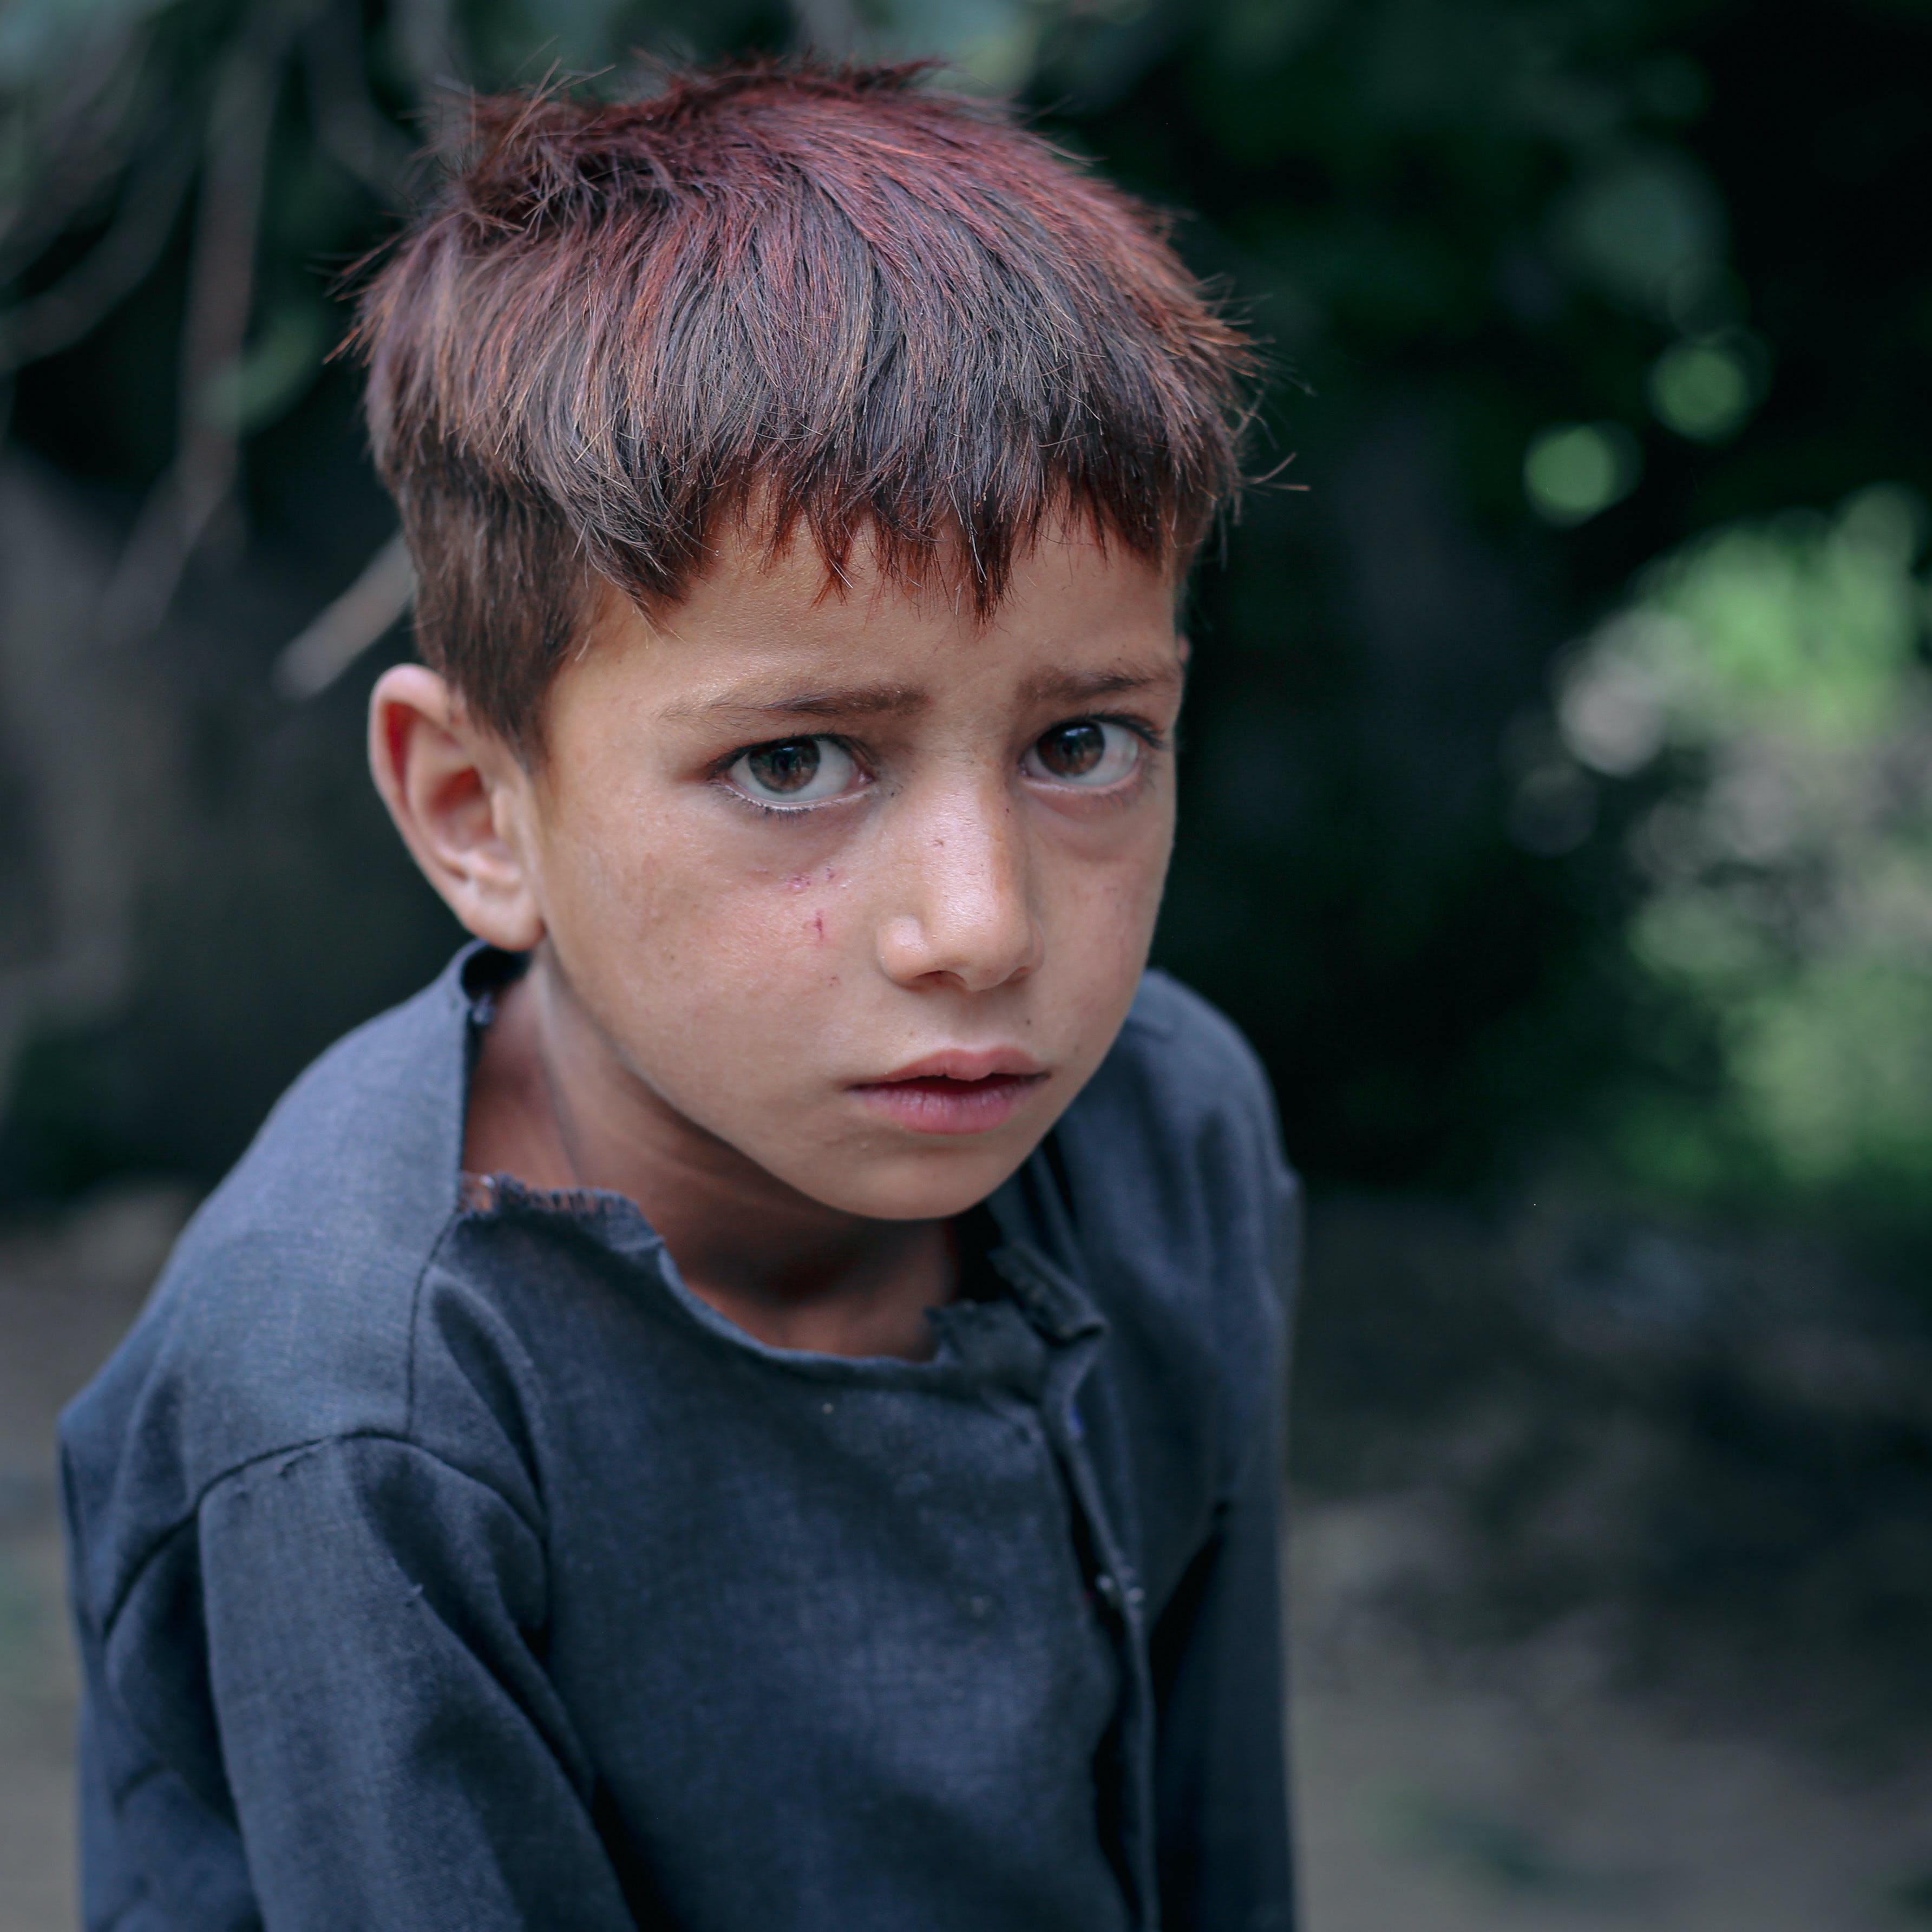
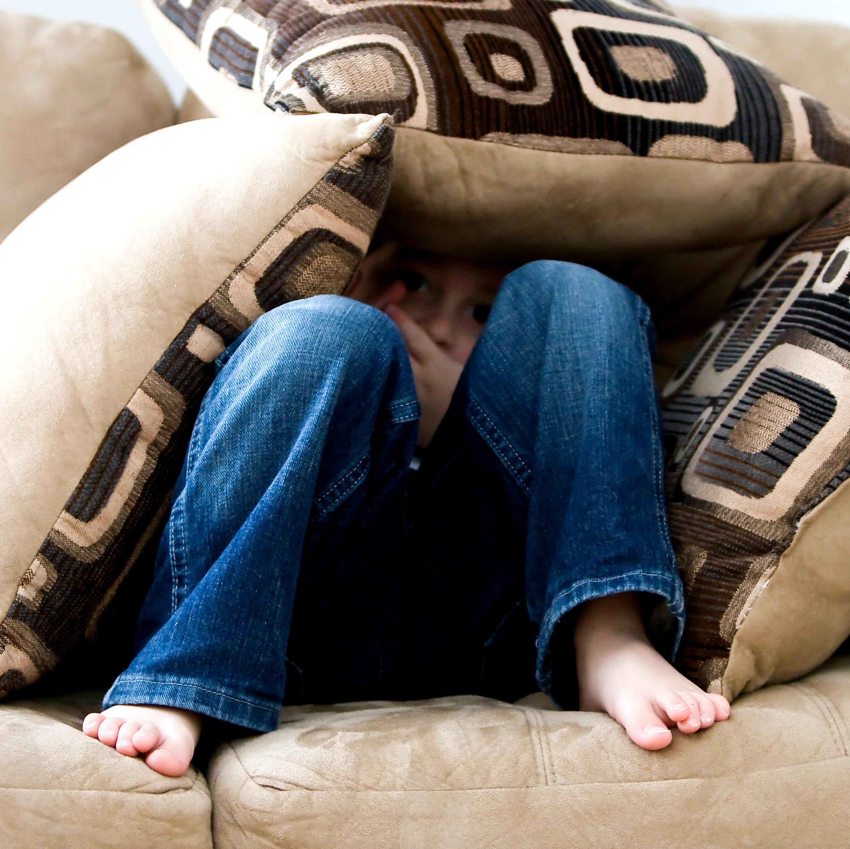
Types of abuse and neglect
Physical Abuse
Neglect
Emotional Abuse
Notes:
There are different types of abuse and neglect.
Physical abuse is the non-accidental use of physical force against another individual which results in harm. Whether or not they intend to do harm doesn’t matter, just their intention to use physical force. (e.g. deliberately pushing an individual who fell and got bruised would be considered physical abuse).
Emotional abuse refers to a pattern of behaviour that intentionally undermines, manipulates, or controls another person's emotions, thoughts, beliefs, or actions. It involves a sustained and systematic use of tactics to diminish an individual's sense of self-worth, autonomy, and well-being, often causing significant emotional distress.
Neglect is the failure by a parent or caregiver to provide a young or vulnerable person with the conditions that are culturally accepted in a society as being essential for physical and emotional development and wellbeing. Neglect includes the non-provision of therapeutic intervention; for example, speech therapy, occupational therapy or counselling.

Slide 10
Types of abuse and neglect
Financial Abuse
Social Abuse
Sexual Abuse
Notes:
Financial abuse refers to a form of domestic or interpersonal abuse where one individual exerts control over another person's financial resources, assets, debts, or financial decision-making to gain power and control over them.
Sexual abuse refers to any form of unwanted or non-consensual sexual activity or behaviour that is forced upon an individual against their will or without their consent.
In the case of children, Sexual abuse is:
"Any act which exposes a child to, or involves a child in, sexual processes beyond his or her understanding or contrary to accepted community standards. Sexually abusive behaviours can include the fondling of genitals, masturbation, oral sex, vaginal or anal penetration by a penis, finger or other object, fondling of breasts, exhibitionism, and exposing the child to pornography or involving the child in child sexual abuse material (child pornography). It includes child grooming, which refers to actions deliberately undertaken with the aim of befriending and establishing an emotional connection with a child to lower the child’s inhibitions in preparation for sexual activity with a child." ³
In the circumstance where a young person is between 16 and 18, it remains sexually abusive for a person in a position of authority, such as a Ministry Agent or Church Council member to commence a sexual or romantic relationship with the young person due to the imbalance of power.
Social abuse refers to a deliberate act of isolating an individual or group of individuals from social interactions and relationships as a form of mistreatment or harm. It involves intentionally cutting off someone's access to social support networks, limiting their opportunities for connection, and depriving them of meaningful human interaction.

Slide 11
Types of abuse and neglect
Spiritual Abuse
Domestic & Family violence
Notes:
Spiritual abuse refers to the misuse or manipulation of religious or spiritual beliefs, practices, or teachings to control, manipulate, or harm individuals or groups. It occurs when someone in a position of power, such as a religious leader, uses their authority to exploit and exert control over others, often in the name of spirituality or religious doctrine. Examples are:
Enforcing one theological position or interpretation of scripture and denying all others.
Persistent debate or gagging debate and questions.
Excessive labouring on sin and evil rather than the freedom and good news of Jesus Christ.
Language or actions that create fear, guilt or self-loathing.
Misuse of scripture or rituals in behaviour management or to justify abuse or neglect.
Domestic and family violence occurs when a family member, partner or ex-partner, or other household member attempts to physically or psychologically dominate the other. It often relates to physical and / or emotional abuse of children or partners. Examples:
Can be criminal and non-criminal.
Patterns of behaviour that exercise power and control over another individual.
Threats to harm pets or people.
Coercive control
Physical, sexual, emotional or psychological abuse.

Slide 12
Indicators of
Abuse, Neglect and Grooming
Notes:
By recognising indicators of abuse, neglect and grooming, we can look out for the safety of others.

Slide 13
Pause and Reflect
What might you notice about the behaviour or appearance of someone who has been or is being abused or neglected that would raise concern?
Notes:
Let’s pause and reflect.
What might you notice about the behaviour or appearance of someone who has been or is being abused or neglected that would raise concern?
Take 2 minutes in groups of 2-3 to discuss.
[Optional Prompts:
What might be a sign of physical abuse?
What might be a sign of neglect – in the young/vulnerable person, or in the parent/carer?
What might be a sign of spiritual abuse?]

Slide 14
Indicators of sexual abuse - Children
Frequent, recurring nightmares / bedwetting / soiling clothes | Unexplained injuries to sexual body parts | Sexual activity or sexual knowledge beyond child’s age or developmental stage | Overly sexualised behaviour / play / themes in artwork
Refusing to talk about ‘secrets’ | Unexplained gifts or money | Recurring themes of power/control in play | Sudden behavioural Shifts
Notes:
People may not directly disclose abuse – either not understanding it is abuse or feeling confident to say something.
For children especially, their behaviour, comments or actions may indicate exposure to sexual abuse.
Research has shown in the overwhelming majority of cases; children do not lie or exaggerate about their experiences of sexual abuse. They are more likely to minimise abuse to protect the perpetrator, as this is often someone close to them.
Indicators of sexual abuse may include:
Frequent, recurring nightmares, bedwetting or soiling clothing.
Unexplained injury to sexual body parts.
Hints about sexual activity or sexual knowledge beyond child’s age or developmental stage.
Overly sexualized behaviour / play / themes in artwork.
Refusing to talk about ‘secrets’.
Unexplained gifts or money.
Recurring themes of power / control in play.
Sudden behavioural shifts.

Slide 15
Grooming
Deliberate actions with aim of befriending and establishing an emotional connection.
Lower inhibitions in preparation for sexual activity.
Criminal offence in Queensland.
Notes:
Grooming is deliberate actions undertaken with the aim of befriending and establishing an emotional connection.
It lowers inhibitions in preparation for sexual activity.
Grooming targets young and vulnerable people, however adults can also be groomed, especially so the perpetrator can gain access to the young or vulnerable person.
Grooming is a criminal offence in Queensland.
Unacceptable behaviours may be due to:
Errors in judgement.
Becoming too familiar.
Crossing boundaries without intending to do harm.
Well-practiced behaviours in exploiting other people.
If on 3 occasions unacceptable behaviour or boundary violations occur, grooming behaviour is suspected and should be reported to your Ministry Agent, who will assist in external reporting if required.
Consider this scenario. You notice a volunteer integrating themselves into the lives of a single parent family with two children. You find over time that the volunteer has made themselves ‘indispensable’ to the family by helping with difficult tasks around the house and coaching the older child in sport. They show a lot of affection towards the children, including asking for hugs and often bringing small toys and gifts as surprises for the children. What might this indicate?
A supporting relationship between the volunteer and the single parent family?
Possible grooming behaviours?
While it is showing support, there are indications of possible grooming behaviour such as the gifts, excessive affection and becoming indispensable, which should be reported.

Slide 16
Possible Indicators of Grooming
Can be difficult to detect or distinguish | Reluctance to be near a particular adult | Fear, dislike or discomfort towards a particular adult | Repeated unacceptable behaviours
Deceptive in nature | Frequent, vague or implausible health complaints | Unexplained gifts, particularly gifts of high value | Displaying harmful or problematic sexual behaviour
Notes:
Grooming can be difficult to discern as individual acts of grooming may not be illegal on their own.
Possible indicators of Grooming:
Reluctance of a child to be near a particular adult.
Fear, dislike or discomfort towards a particular adult.
Repeated unacceptable behaviours. Please report internally so repetitive behaviours can be identified and followed-up.
Deceptive in nature.
Frequent, vague or implausible health complaints such as headaches or tummy aches.
Unexplained gifts, particularly gifts of high value.
Displaying harmful or problematic sexual behaviour.
While these are possible indicators of Grooming, it does not automatically mean abuse or grooming is occurring. There may be valid explanations for this such as a change in the home environment, moving to a new house, or the death of a family member. Please report concerns to your Ministry Agent.

Slide 17
Pause and Reflect
What are some behaviours that could indicate grooming is taking place:
In a perpetrator?
In a young or vulnerable person?
Notes:
Let’s pause and reflect.
What are some behaviours that could indicate grooming is taking place:
In a perpetrator?
In a young or vulnerable person?
Take 2 minutes in groups of 2-3 to discuss.
[Possible answers:
Persistent breaking of ‘minor’ rules about conduct and boundaries.
Persistent and excessive physical contact with children.
Encouraging others to breach acceptable behaviours.
Having an obvious ‘favourite’ child who receives preferential treatment, gifts or rewards.]

Slide 18
Unacceptable
Behaviours
Notes:
It’s important to recognise, address and report unacceptable behaviours.

Slide 19
Behaviours
C2.1.2.7.1 – List of Acceptable Behaviours
C2.1.2.7.2 – List of Unacceptable Behaviours
Physical | Emotional
Behavioural | Spiritual
Notes:
We want people to learn about God and grow in their faith – if they don’t feel safe, this won’t happen.
Individually and collectively, we have shared guardianship in maintaining acceptable physical, emotional, behavioural and spiritual boundaries.
We need to speak up about unacceptable behaviours, especially where a power imbalance exists:
Adults – children.
Ministry Agent – Church member.
We encourage you to continue modelling acceptable behaviours.

Slide 20
“STOP! We don’t do that here, please don’t do it again”
Raise your concerns
“It’s the policy of the Church”
Notes:
Interrupt any unacceptable behaviour or boundary violations so that people can interact in a safe way.
We encourage you to normalise challenging problematic behaviour in our Safe church culture.
When responding to unacceptable behaviour:
Be firm, polite and non-judgemental.
Don’t make assumptions about the motives of why someone has violated a boundary.
Don’t be afraid of the role of the person – we are all accountable to each other in behaving appropriately.
As you learned in the Introductions Module:
Communicate firmly:
“Stop! We don’t do that here, please don’t do it again.”
“It’s the policy of the Church”.
Raise your concerns with your Ministry Agent, or another trusted leader and report it as soon as possible.

Slide 21
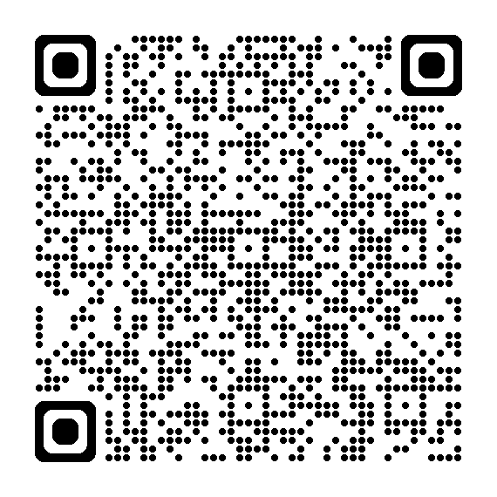
Scan to report a concern or incident of:
Notes:
Remember to Speak Up! Safety is everybody’s responsibility.
The QR code or link on the Hub guides you through the internal Mandatory Reporting Process.
Remember you can report actual or suspected abuse, neglect or boundary violations.
External reporting may also need to occur, please be guided by your Ministry Agent.

Slide 22
Responding to
Disclosure
Notes:
This final section guides you through responding to disclosures.

Slide 23
Responding to disclosure
C2.1.2.12 – Mandatory Reporting for Lay Preachers and Lay Workers
Notes:
Consider – what might go through your mind if you have just become aware of abuse?
Often people feel unprepared, and it may come as a shock.
The situation may be overwhelming.
Your brain might trigger the fight, flight or freeze responses.
A strategy for responding to disclosures is the acronym B.C.A.L.M.
This acronym also forms part of the Mandatory Reporting for Lay Preachers and Lay Workers.

Slide 24
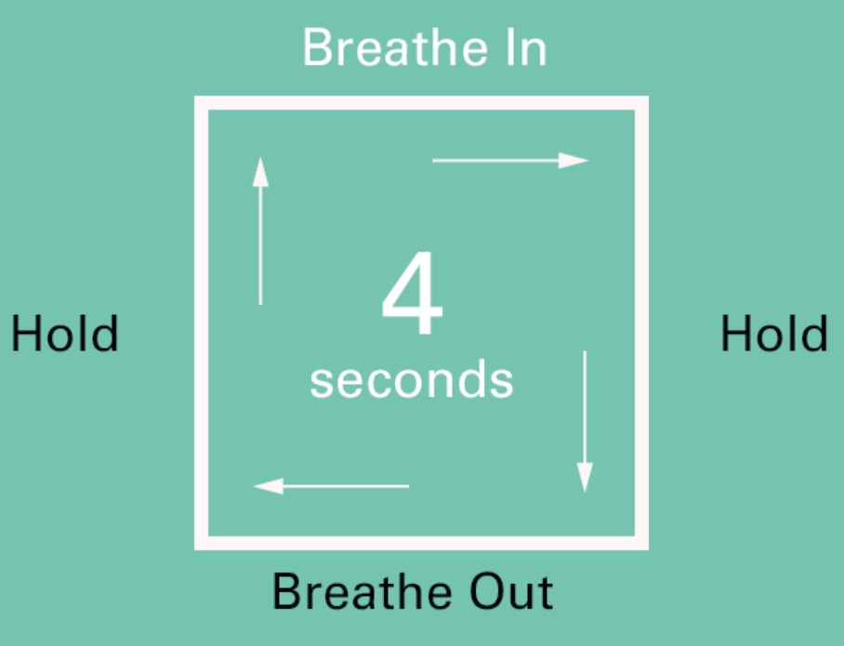
Breathe
C2.1.2.12 – Mandatory Reporting for Lay Preachers and Lay Workers
B
Use a quick, calming technique.
Suggest the person ‘take a deep breath’
Notes:
Breathe
Using a quick calming technique can help you engage your thinking brain.
Suggest the person ‘take a deep breath’
Use the box breathing method to count - Breathe in for 4 seconds, hold for 4 seconds, breathe out for 4 seconds and hold for 4 seconds. Repeat as needed.

Slide 25
Calm the person
C2.1.2.12 – Mandatory Reporting for Lay Preachers and Lay Workers
C
Stay focused on them and their story.
The words you use will have a profound and lasting impact.
You’ve done the right thing by telling me.
I believe you.
It wasn’t your fault.
Notes:
Calm the person
Stay focused on the person and their story.
It may be an adult or a child.
It may be disclosing current abuse or past abuse.
Sometimes people live with this trauma for many years before telling.
The words you use will have a profound and lasting impact on the person.
You’ve done the right thing by telling me.
I believe you.
It wasn’t your fault.

Slide 26
Assess immediate danger
C2.1.2.12 – Mandatory Reporting for Lay Preachers and Lay Workers
A
If there is, call 000 and ask for police.
Gently ask questions to assess, if not mentioned outright.
Seek support from another leader / Ministry Agent to ensure the physical safety of yourself and the person disclosing.
Notes:
Assess whether there is any immediate danger. If there is, call 000 and ask for police to attend.
If someone is in danger, they may not feel confident saying this outright.
Gently ask questions early in the conversation to help assess this.
What could you ask to see if someone is in danger?
[Are you afraid to return home?
Do you feel threatened for yourself or anyone else?
Do you have a safe location to go to?]
Seek support from another leader / Ministry Agent to ensure the physical safety of yourself and the person disclosing.

Slide 27
Let them know your obligations
C2.1.2.12 – Mandatory Reporting for Lay Preachers and Lay Workers
L
Manage expectations by explaining the next steps.
I need to tell someone else.
Explain your responsibility to report child abuse concerns and allegations.
Notes:
Let the person know your obligations.
Manage expectations by explaining the next steps such as:
I need to tell someone else.
I’m going to have to make a report.
Information will need to be shared with the Ministry Agent or Police.
Explain your responsibility to report child abuse concerns and allegations such as:
Current abuse.
Historical abuse.

Slide 28
Make a report
C2.1.2.12 – Mandatory Reporting for Lay Preachers and Lay Workers
M
Inform Ministry Agent or complete internal reporting (QR code, link or call)
Report externally suspected or actual abuse/grooming.
Notes:
Make a report immediately.
Inform Ministry Agent or complete the ‘Speak up!’ internal reporting via QR code, link or phone call.
Respect the privacy and dignity of all parties.
If the concern is about the Ministry Agent or Presby Chair or their family, you can report to the Presbytery Chair or Synod Office respectively.
Report externally:
Suspected or actual child abuse, neglect or grooming to police
Adult abuse – encourage the individual to report to police.
Violence or domestic violence to police.
Abuse of vulnerable people to the Office of the Public Guardian.
Your Ministry Agent can assist with making a report to the police or relevant group.
Document what information was given to which person.

Slide 29
Always call 000 if someone is in immediate danger or life-threatening danger!
Notes:
Another reminder – always call 000 if someone is in immediate or life-threatening danger!

Slide 30
Responding to disclosure
C2.1.2.12 – Mandatory Reporting for Lay Preachers and Lay Workers
Notes:
B.C.A.L.M
[You can see if attendees can assist with what each letter stands for]
B – Breathe
C – Calm the person
A – assess immediate or imminent danger
L – Let them know your obligations
M – Make a report

Slide 31
Quiz
Safe Church – Foundations (Lay)
Notes:
Let’s have a look at a few questions related to this module.

Slide 32
Q1: What is the relationship between abuse and harm?
Abuse and harm mean the same thing – either word can describe the action or impact of the action.
Abuse is the action taking place; harm is the impact of that action.
Abuse is the action taking place; harm is only the emotional response to the action.
A
B
C
Notes:
Question 1: What is the relationship between abuse and harm?
Abuse and harm mean the same thing – either word can describe the action or impact of the action.
Abuse is the action taking place; harm is the impact of that action.
Abuse is the action taking place; harm is only the emotional response to the action.

Slide 33
Q1: What is the relationship between abuse and harm?
Abuse and harm mean the same thing – either word can describe the action or impact of the action.
Abuse is the action taking place; harm is the impact of that action.
Abuse is the action taking place; harm is only the emotional response to the action.
A
B
C
Notes:
Answer:
B. Abuse is the action taking place; harm is the impact of that action.

Slide 34
Q2: A child that regularly attends Sunday School appears sad, quiet and is not participating in the activities. The child discloses they are upset because a volunteer yelled at them and pushed them. What should you do?
Listen to the child, but take no action.
Don’t believe the child as you know the volunteer well.
Care for the child and use B.C.A.L.M to respond and report appropriately.
A
B
C
Notes:
Question 2: A child that regularly attends Sunday School appears sad, quiet and is not participating in the activities. The child discloses they are upset because a volunteer yelled at them and pushed them. What should you do?
Listen to the child, but take no action.
Don’t believe the child as you know the volunteer well.
Care for the child and use B.C.A.L.M to respond and report appropriately.

Slide 35
Q2: A child that regularly attends Sunday School appears sad, quiet and is not participating in the activities. The child discloses they are upset because a volunteer yelled at them and pushed them. What should you do?
Listen to the child, but take no action.
Don’t believe the child as you know the volunteer well.
Care for the child and use B.C.A.L.M to respond and report appropriately.
A
B
C
Notes:
Answer:
C: Care for the child and use B.C.A.L.M to respond and report appropriately.

Slide 36
Q3: Grooming refers to actions deliberately undertaken with the aim of befriending and establishing an emotional connection with a young or vulnerable person, to lower their inhibitions in preparation for sexual activity. Could parents and other adults also be groomed?
Yes – to create a situation where the perpetrator can sexually offend the young or vulnerable person.
No – grooming only impacts a young or vulnerable person.
A
B
Notes:
Question 3: Grooming refers to actions deliberately undertaken with the aim of befriending and establishing an emotional connection with a young or vulnerable person, to lower their inhibitions in preparation for sexual activity. Would parents and other adults also be groomed?
Yes – to create a situation where the perpetrator can sexually offend the young or vulnerable person.
No – grooming only impacts a young or vulnerable person.

Slide 37
Q3: Grooming refers to actions deliberately undertaken with the aim of befriending and establishing an emotional connection with a young or vulnerable person, to lower their inhibitions in preparation for sexual activity. Could parents and other adults also be groomed?
Yes – to create a situation where the perpetrator can sexually offend the young or vulnerable person.
No – grooming only impacts a young or vulnerable person.
A
B
Notes:
Answer:
A: Yes – to create a situation where the perpetrator can sexually offend the young or vulnerable person.

Slide 38
Q4: Which of the following would be an example of spiritual abuse?
Enforcing a theological opinion that is opposite to the theology of the Church.
Using language, including scripture or prayer to create fear and self-blame.
Use of scripture to facilitate or justify subjecting a child to physical, emotional or sexual abuse or neglect.
All of the above.
A
B
C
D
Notes:
Question 4: Which of the following would be an example of spiritual abuse?
Enforcing a theological opinion that is opposite to the theology of the Church.
Using language, including scripture or prayer to create fear and self-blame.
Use of scripture to facilitate or justify subjecting a child to physical, emotional or sexual abuse or neglect.
All of the above.

Slide 39
Q4: Which of the following would be an example of spiritual abuse?
Enforcing a theological opinion that is opposite to the theology of the Church.
Using language, including scripture or prayer to create fear and self-blame.
Use of scripture to facilitate or justify subjecting a child to physical, emotional or sexual abuse or neglect.
All of the above.
A
B
C
D
Notes:
Answer:
D: All of the above.

Slide 40
Q5: Which of the following is NOT a sign of possible sexual abuse?
Unexplained injuries to sexual body parts.
Refusing to talk about ‘secrets’.
Gifts that are easily explained, such as for a birthday.
Overly sexualised themes in artwork.
A
B
C
D
Notes:
Question 5: Which of the following is NOT a sign of possible sexual abuse?
Unexplained injuries to sexual body parts.
Refusing to talk about ‘secrets’.
Gifts that are easily explained, such as for a birthday.
Overly sexualised themes in artwork.

Slide 41
Q5: Which of the following is NOT a sign of possible sexual abuse?
Unexplained injuries to sexual body parts.
Refusing to talk about ‘secrets’.
Gifts that are easily explained, such as for a birthday.
Overly sexualised themes in artwork.
A
B
C
D
Notes:
Answer:
C: Gifts that are easily explained, such as for a birthday.
If a gift was not easily explained, it may be a sign of possible grooming or sexual abuse.

Slide 42
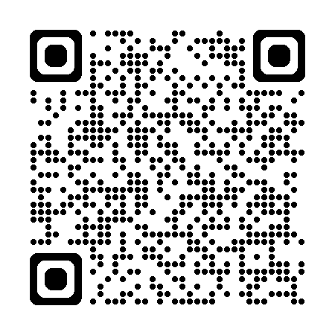
Thankyou!
Resources on The Hub:
hub.ucaqld.com.au
Contact Safe Church Unit:
safechurch@ucaqld.com.au
(07) 3377 9833
Notes:
Thank you so much for your time and effort with the training.
Safe Church resources can be found on The Hub.
Connect with the Safe Church Unit if you have any questions.

